Slide 1
Mini-projet 1
Mes préférences
cinématiques

Slide 2
How do I pass? /30
 | 0 1 (20%) | 2 (40%) | 3 (60%) | 4 (80%) | 5 5+ (100%+)
ORAL - Fluency | Does not speak | Rarely speaks | Speaks with some hesitation, needs prompting | Speaks with spontaneity | Speaks spontaneously, clear and confident!
ORAL – Accuracy | Does not speak, impossible to understand | May be hard to understand the message, many incorrect words | Comprehensible, still some errors in structures, grammar | Most structures correct, some errors, pronunciation clear | Few errors – pronunciation excellent!
ORAL – Ideas and use of language | Uses words rather than sentences | Limited number used | Uses modeled sentences with some personal details | Lots of personal details added, easy to understand | Creates new sentences, extra details included!
WRITING and REPRESENTING – organization | Thoughts not organized, no preplanned | Lack of organization | Some organization in visual | Well-organized visual | Excellent visual! Exemplary!
CREATIVITY (scored out of 10) | ____________ | ____________ | Lacks creativity | Shows creative thinking in project | WOW! Student is thinking outside the box!

Slide 3
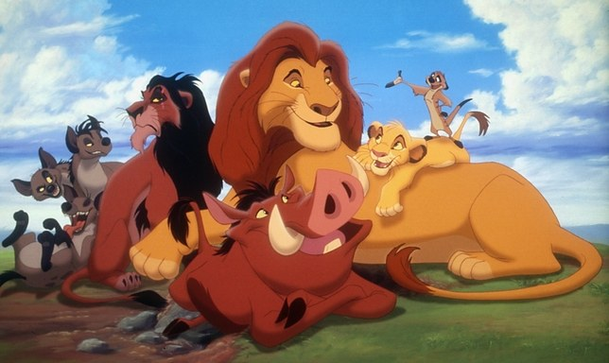
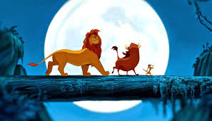
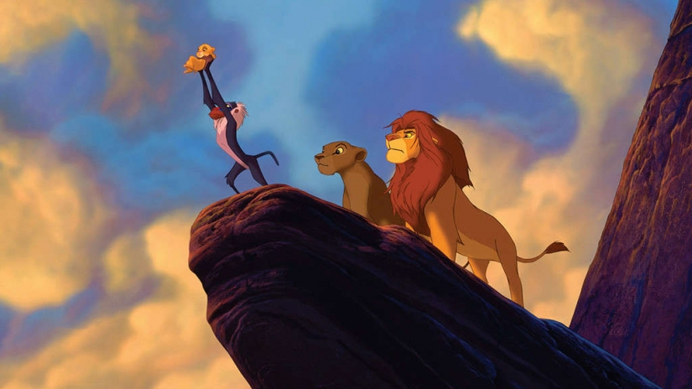
The Lion King

Slide 4
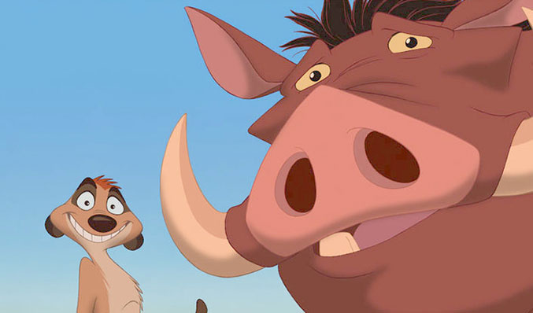
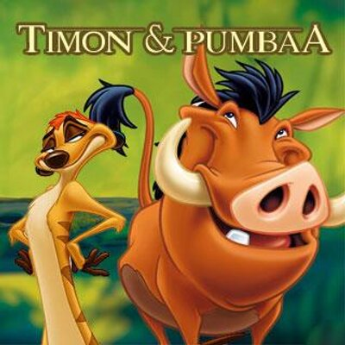
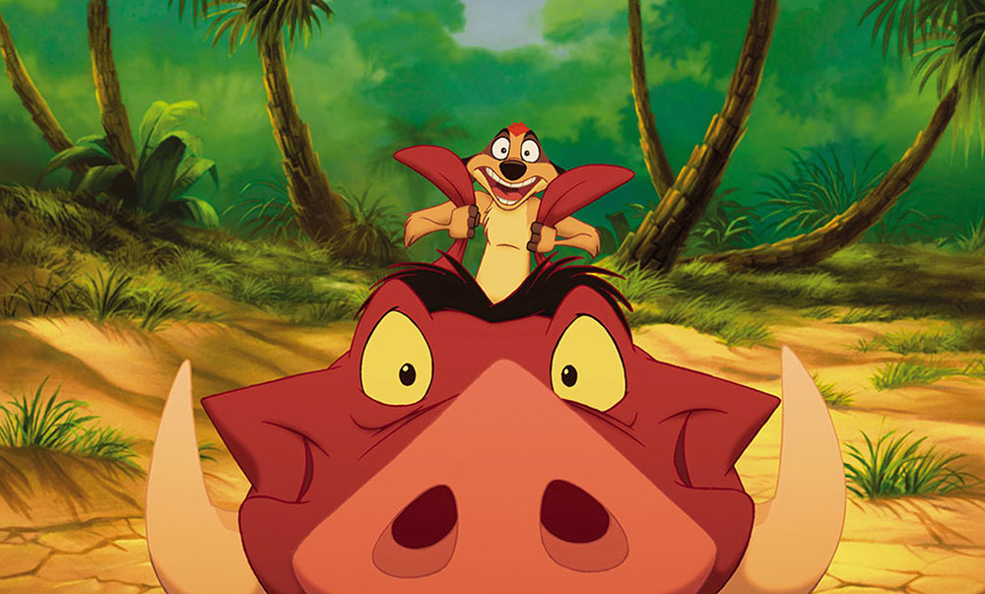

Slide 5
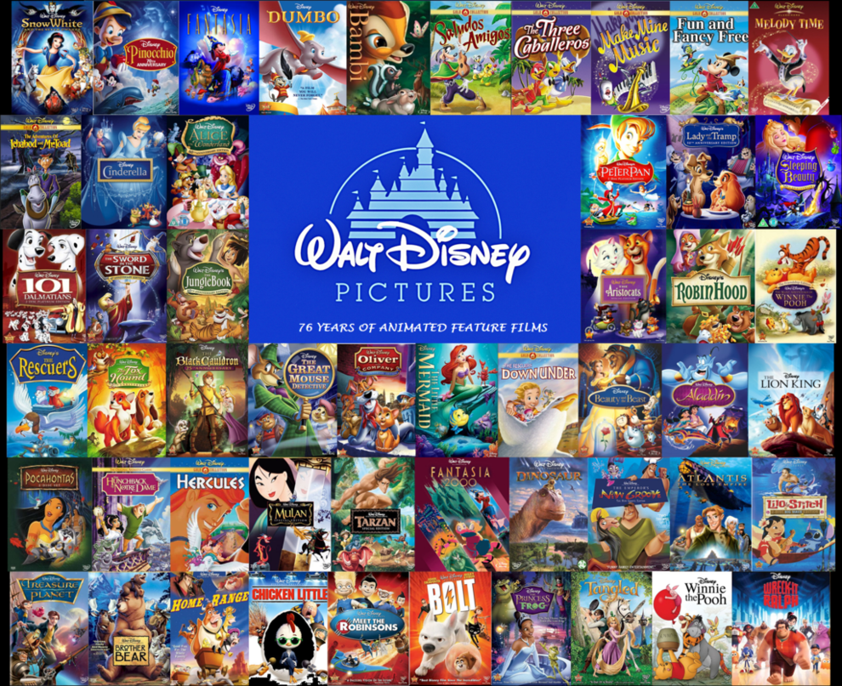

Slide 6
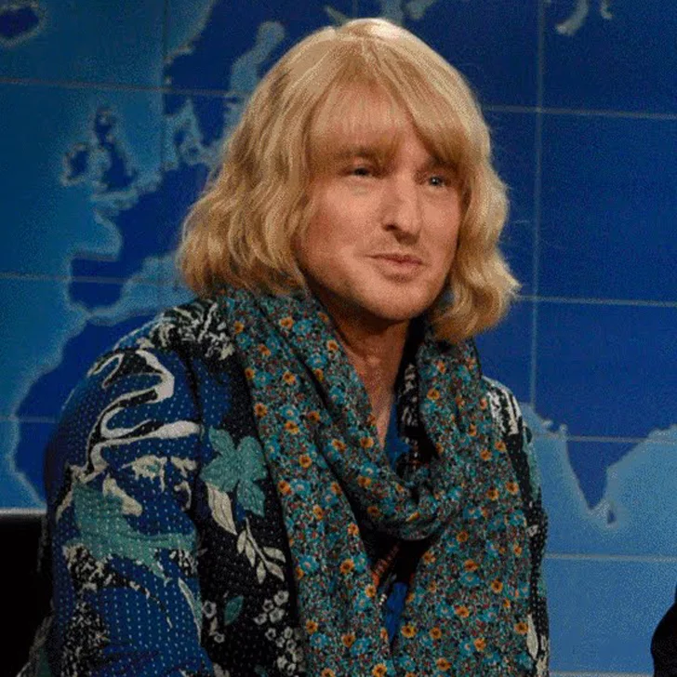
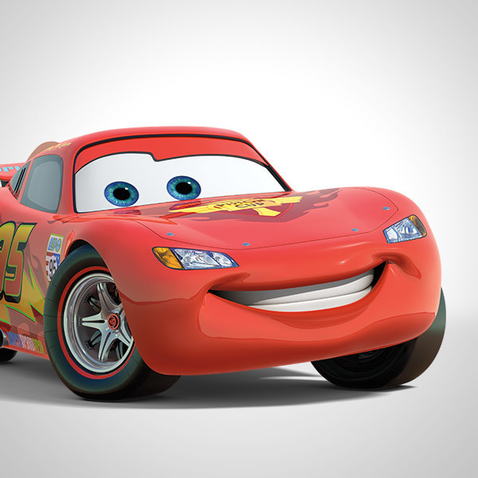
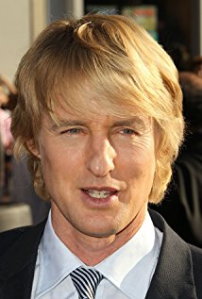
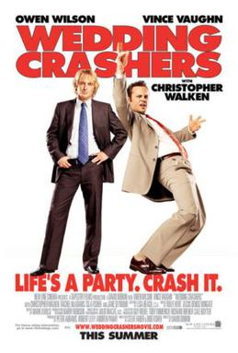
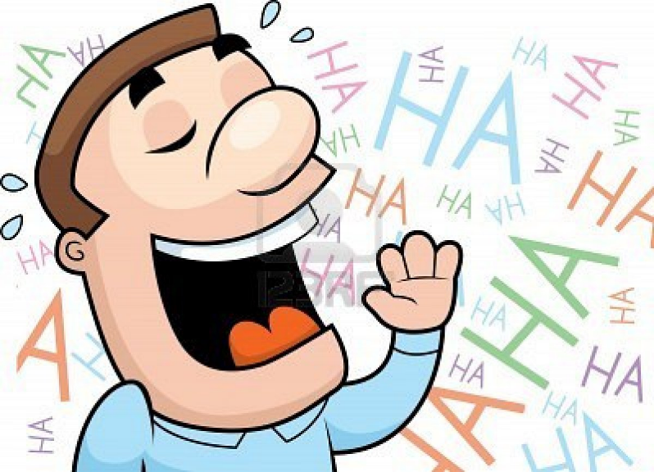
Owen Wilson

Slide 7
Owen Wilson

Slide 8
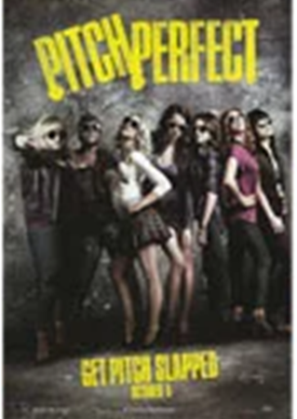
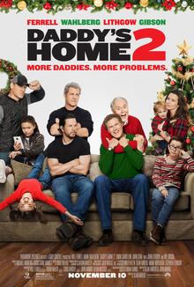
Des comédies

Slide 9
Des comédies

