Slide 1
Fortune Teller Project
Can I feed the world?
What will average yields of Canadian potatoes be in 2050?

Slide 2
Why?
Potatoes are a staple in the diet of Canadians
Potato sector plays a major role in the Canadian economy and employment
In 2016, farm cash receipts exceeded $1.2 billion
To support growing global population, the challenge is for farmers to produce more potatoes on smaller acreages
Source: Statistics Canada (CANSIM Table 002-0001)

Slide 3
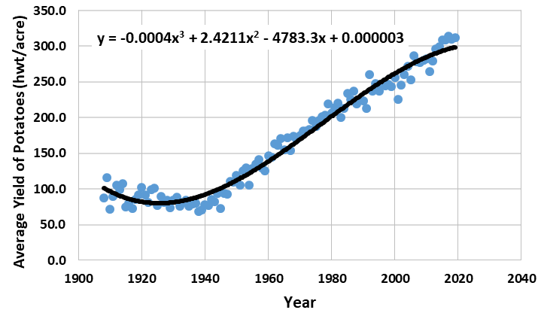
Figure 1: Average yield of potatoes in Canada from 1908 to 2019
Source: Statistics Canada, Table: 32-10-0358-01 (formerly CANSIM 001-0014)

Slide 4
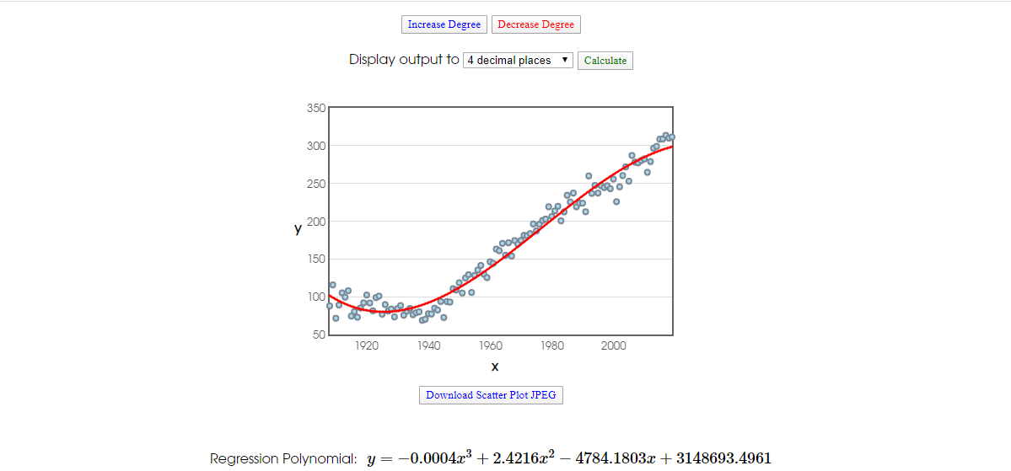
Figure 2: A second opinion – average yield of potatoes in Canada from 1908 to 2016.
Source: Stats Blue Software http://stats.blue/Stats_Suite/polynomial_regression_calculator.html

Slide 5
Prediction for 2050
Based on calculation, estimation for 2050 is 71848 hwt/acre
WHAT?!
Not a reliable prediction – This assumes there will be drastic changes in production in the next three decades, which is unlikely. Today’s potato production is a well-oiled machine with fertilizer, pesticide and other inputs used to optimize yield.
Closely examining the graph suggest that there might be two relationships at play…

Slide 6
Figure 3: Average yield of potatoes in Canada from 1908 to 2019
Two linear functions instead?
Source: Statistics Canada, Table: 32-10-0358-01 (formerly CANSIM 001-0014)

Slide 7
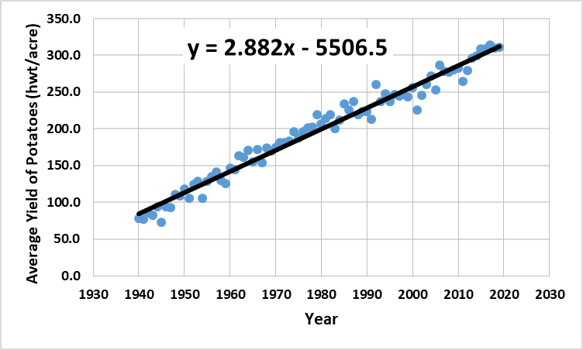
Figure 4: Average yield of potatoes in Canada from 1940 to 2019

Slide 8
NEW Prediction for 2050
Based on linear regression model based on data collected from 1940 to 2019, prediction becomes 401.6 hwt/acre
This answer is more logical and better reflects currently realities of farmers. Farmers are improving yield, but at a more modest rate.

