Slide 1
Stopwatch Cards
Stopwatch Cards
Create a Variable
Start the Clock
Stop and Reset
Get Moving
Time the Sprite
Background Effects

Slide 2
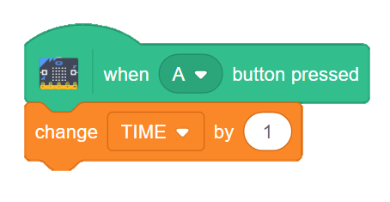
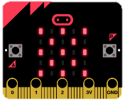
Create a Variable
Create a Variable
GET READY
GET READY
Add a changeable value on the screen.
Choose in the Blocks Palette.
Add a checkmark to your variable to make it appear on the screen.
ADD THIS CODE
ADD THIS CODE
TRY IT
TRY IT
Click the A button to advance the number on the screen.
1

Slide 3
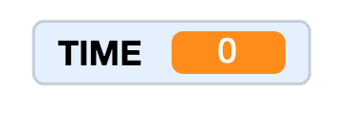
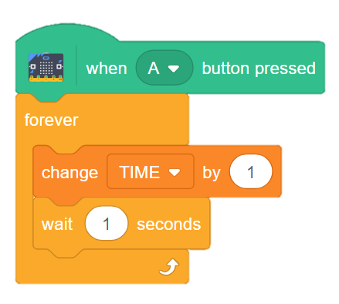
Start the Clock
Start the Clock
GET READY
GET READY
Add a loop to increase the time on the clock.
A stopwatch should advance each second.
A forever loop will increase the time as long as the program is running.
ADD THIS CODE
TIME will increase by 1 each second.
TRY IT
Test your timer against a clock.
Does the time change each second?
2

Slide 4
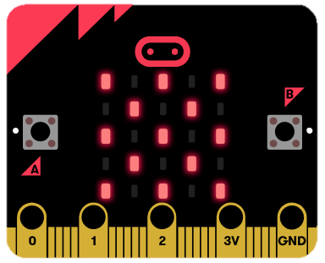
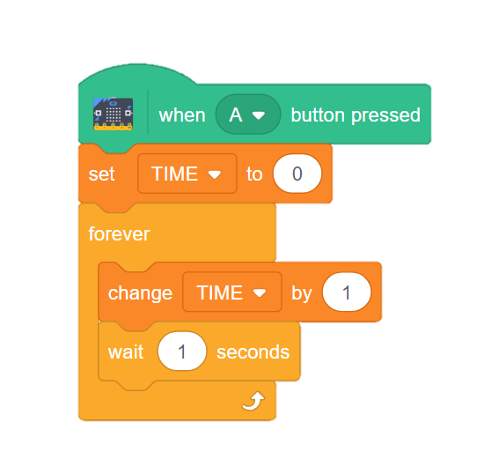
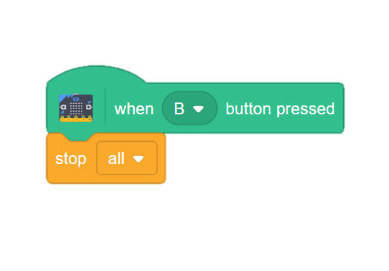
Stop and Reset
Stop and Reset
GET READY
GET READY
Control your stopwatch with the A and B buttons.
Add a RESET and a STOP code.
ADD THIS CODE
TIME will return to 0 each time the A button is pressed.
A
B
TRY IT
Click each button on the micro:bit and see how they affect the time displayed on screen.
CHALLENGE: Can you change your stopwatch into a countdown clock?
3

Slide 5
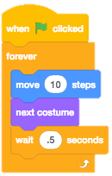
Get Moving
Get Moving
GET READY
GET READY
Make your sprite move as your stopwatch advances!
Click the tab.
Make sure your sprite has more than one costume.
Choose a sprite.
ADD THIS CODE
TRY IT
What happens when your sprite reaches the end of the screen?
Add these codes into the loop to fix the problem!
4

Slide 6
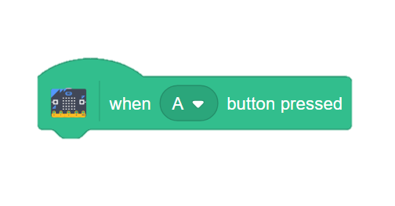
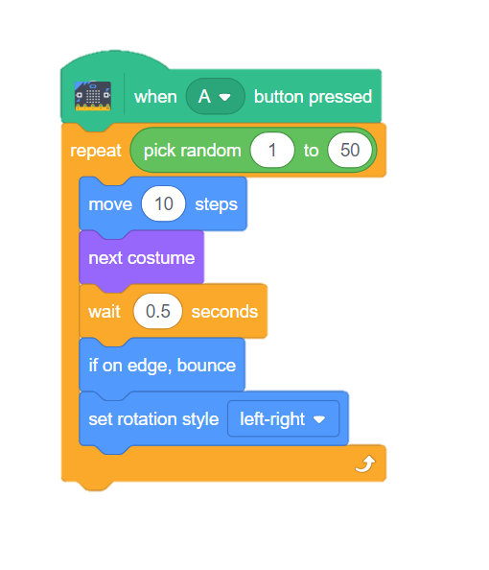
Time the Sprite
Time the Sprite
GET READY
GET READY
Let Scratch decide how many seconds your sprite will move. Use your stopwatch to figure it out.
Start your sprite with the A button.
This will make the stopwatch and the sprite move at the same time.
ADD THIS CODE
Let Scratch decide how long the code will run.
Change the number to affect the sprite’s speed.
TRY IT
How long did the sprite move?
Freeze the clock by pushing the B button on the micro:bit when the sprite stops.
5

Slide 7
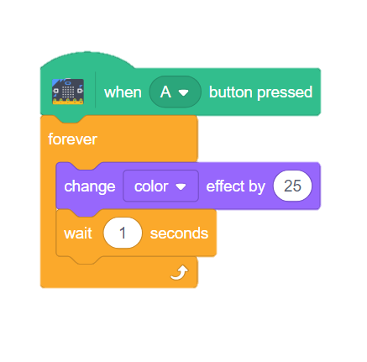
Background Effects
Background Effects
GET READY
GET READY
Use graphic effects to alter your background as the program runs.
Choose a background.
Click the Backdrops tab.
ADD THIS CODE
TRY IT
TRY IT
Experiment with other background effects.
CHALLENGE: Reset your graphic effect. Where should this block go in your code?
6

