Slide 1
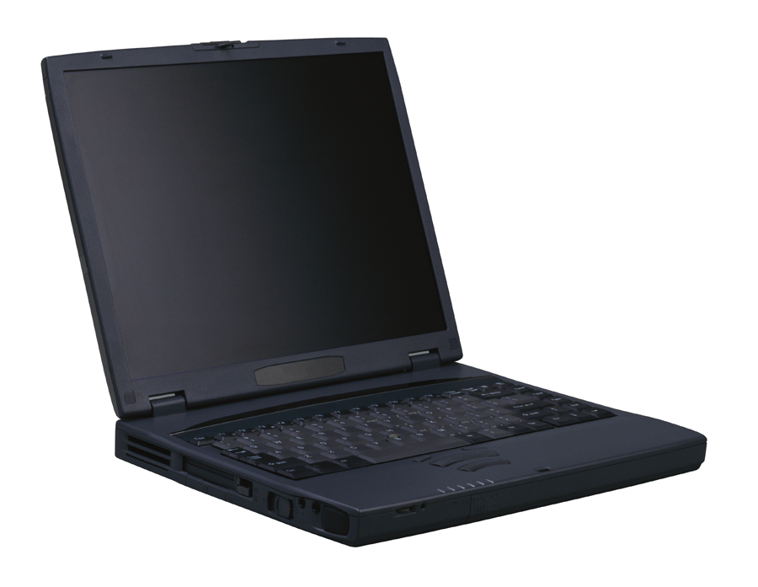
NB Department of Education Policy 311
Acceptable Use of School Computers

Slide 2



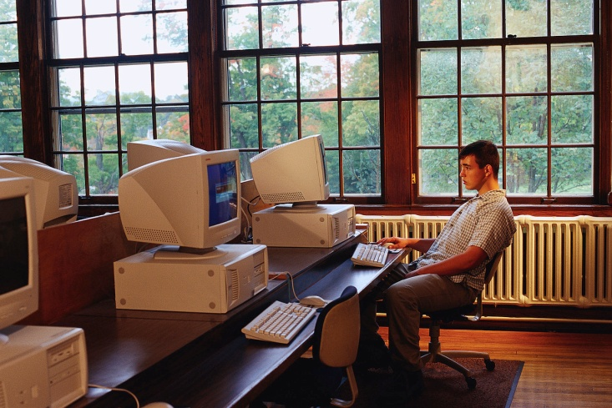
Policy 311 Applies To…
Students
Teachers
Other school personnel
Volunteers
Community Access Centres located in schools

Slide 3

The Policy Applies…
24 hours a day
seven days a week

Slide 4

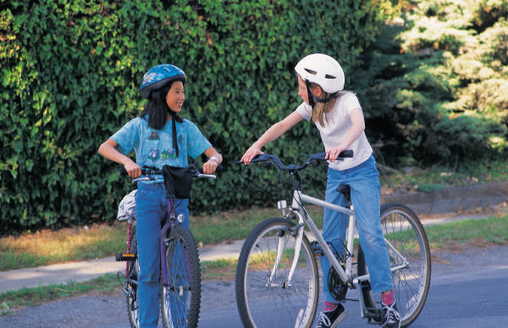

Policy 311
MUST NOT –
    Store or install large files for recreational (personal) purposes
graphics
games
photos
music

Slide 5
Policy 311
YOU CAN – use the network resources to:
    access and store files for educational purposes as instructed by your teacher
graphics
games
photos
music

Slide 6
Policy 311
YOU MUST NOT:
    create, access, store, send or print anything that is hate motivated, demeaning, obscene or otherwise objectionable
Altering photos in unacceptable ways
Inappropriate screensavers, wallpaper
Cyberbullying
Inappropriate use of e-mail
Inappropriate Personal websites

Slide 7

Policy 311
YOU MUST NOT:
    Obtain access to any system or electronic material to which you are not entitled
Only access your own files & those you have been given permission by the teacher to access.
No hacking
Use your own computer

Slide 8
Policy 311
YOU MUST NOT:
    Spread computer viruses intentionally
    Transmit unsolicited bulk information (SPAM)
Jokes
Junk mail
Chain letters

Slide 9

Policy 311
YOU MUST NOT:
    Use instant messaging or non-educational chat sites
    Make changes to computer files that are not yours

Slide 10


Policy 311
YOU MUST:
    Respect a person’s or organization’s copyright for text and images found on the Internet.

Slide 11


Policy 311
YOU MUST:
    Have signed permission to post or release information and/or images of anyone, teachers or students

Slide 12

Policy 311
YOU MUST:
    Use only the email account provided by your school district
    abcdxxxxx@student.nbed.nb.ca
    Your username@student.nbed.nb.ca
NO Hotmail or other free accounts

Slide 13
Failure to comply?
May result in…
  Disciplinary action (detention, suspension)
  Parental contact
  Loss of computer privileges

Slide 14





Any Questions?

Slide 15

Let’s take a closer look at copyright information…

Slide 16

What is Copyright?
The right to copy
Pictures
Text
Broadcast signals
Plays
Performances

Slide 17

Why and When Does it Exist?
It protects ORIGINAL work and allows the creator to control the use of the work.
It exists as soon as the work is created. It need not be registered!
Student work?

Slide 18
Material NOT Protected (meaning you CAN copy)
Works in the public domain (50 years after death of creator or before if creator chooses so).
Titles, names, characters and short series of words
  They may be subject to trademark!
GUND®
Ideas, facts, news
  Beware of “manner” you express it
Hamlet
Madona
Winnie-the-Pooh

Slide 19
Misconception 1:
If I cite the source in a bibliography, I am not breaking copyright.
www.disney.com

Slide 20
Misconception 2:
If I can’t find a copyright statement on the material I can use it.

Slide 21
Misconception 3:
If I’m only copying material for a school project (no profit), then I’m not violating copyrights.
Not necessarily!

Slide 22
Misconception 4:
If a work is in the public domain, all photographs of the work are also in the public domain.

Slide 23

Misconception 5:
E-mails I receive are mine. I can use them as I wish.

Slide 24

NO, YOU CAN’T!
(for educational purposes)
Copy ANY pictures, text, or video clips, etc without permission of the owner
Use original music if you are going to sell the project.

Slide 25
YES, YOU CAN!
(for educational purposes)
Access material in public domain
“Fair Deal.” Use “SMALL” parts of works not in public domain for private study or research:
  periodical article
  newspaper article, encyclopedia entry, annotated bibliography or similar reference
  short story, play, poem, or essay from a book or periodical containing other works

Slide 26
YES, YOU CAN!
(for educational purposes)
Use copyright-free picture sites (check carefully… you may be required to cite source!)
Draw copyrighted pictures by hand (you may still have to mention trademark)
Use music and perform plays (if not selling!)
  Music must come from a legitimate source (bought CD) not peer-to-peer sharing (ie: Limewire)
  Audience must primarily be students and teachers

Slide 27
References
All images from Microsoft; used in accordance with software license.
The Canadian Intellectual Property Office CIPO administers the intellectual property (IP) system in Canada and disseminates IP information on areas including: patents, trademarks, copyright, industrial design, and integrated circuit topographies.
The copyright section of the site includes:
  Copyright Protections – a comprehensive overview of copyright
  Registration of Copyright – how to register copyright
  A Glossary of Terms related to Copyright

Slide 28
References
The Copyright Act on the Department of Justice Canada Website
Copyright Regulations on the Department of Justice Canada Website
The Copyright Policy Branch of the Department of Canadian Heritage, in co-operation with the Intellectual Property Policy Directorate of Industry Canada, is responsible for formulating and implementing an integrated Canadian copyright policy.
The Copyright Policy Branch Web site provides regular updates on copyright new and developments. Be sure to check out the What’s New link and the General Information/FAQ link.

Slide 29
References
Council of Ministers of Education, Canada This site contains copyright information, especially as it relates to educators. It includes:
Copyright Matters! A FAQ designed for teachers
CMEC’s proposed amendment to the copyright act to permit educational use of freely available Internet resources
University of Wisconsin – Madison Writer’s Handbook This site contains tips for writers, including how to cite references.

