Slide 1
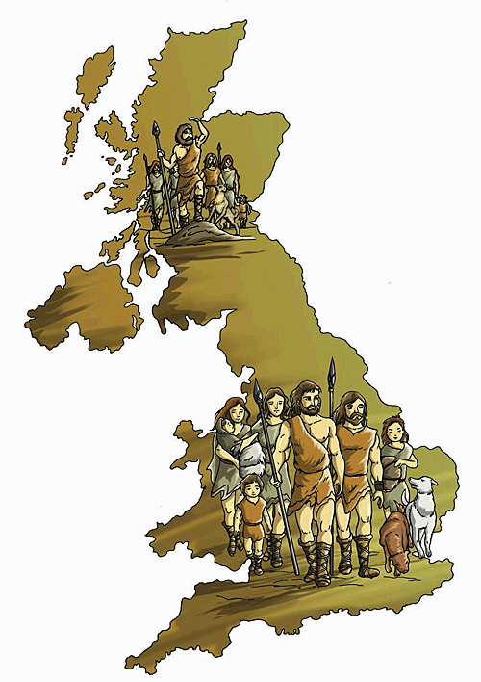
Poetry Unit
Anglo Saxon Era
(to 1066)

Slide 2
Origins of our English Language
Where does our language come from?
What influenced our language?
What is the first written work that has survived from the Anglo Saxon era?
What does Anglo Saxon mean?

Slide 3
Words You’re Going to Need to Know
Stoicism
Caesura
Kennings
Alliteration
Wergild
Pagan
Hyperbole
Fatalism
Minstrel
Epic
Theme
Motif
Archetype
Foil
Anecdote
Didactic

Slide 4
Anglo-Saxon Period
First people were mainly Celts.
Romans arrived-built walled cities and roads. They tried to take over.
Celts enlisted the help of the Jutes, a tribe from Germany. They fought well, but they also refused to leave.
Angles and Saxons arrive (Teutonic tribes-relatives of the Jutes.) They overran England and drove the Celts north.
The period was a time of immense political and social upheaval.

Slide 5
Our Language Develops…
First influences to our language comes from the Celts and the Romans.
By mid 6th century, the Jutes, Angles and Saxons were the ones who mostly influenced our language. These tribes mainly spoke in dialects similar to Dutch or Low German.
History has labeled the speech of all three as “Old English,” however, it was mainly the language of the Saxons. (More of their manuscripts survived for scholars to study. )

Slide 6
Germanic words make up just 1/5 of our English vocabulary, but we use them more often than any other words; they are the core of the English language.
Ex:
hand, leg, thumb
man, wife, child
sun, moon, stars
love, hate, friend
sleep, hungry, food, milk
Old English lasted from approx. 700 to 1150 AD.

Slide 7
Lifestyles of the Anglo Saxons
Religious Beliefs
At first, the Teutonic tribes were pagans (They worshipped gods of nature and held springs, wells, rocks and trees in reverence.)
They would pray to the gods/goddesses in order to secure a desired outcome in the material world. Ex: for a successful harvest, or for victory in battle.
They believed in fatalism-that their fates were in the hands of these gods.
The Romans brought Christianity with them and almost all of the empire was Christianized by 800 AD. This changed their beliefs from polytheistic to monotheistic.

Slide 8
Everyday Life
Was rough! They lived during a very dangerous time:
Feuds, famines, wars, capital punishment, epidemics.
When they weren’t battling, leisure time included: dice/board games, elaborate riddles, horse racing, hunting, feasts, juggling balls/knives, church gatherings.
Infant mortality was high.
Life expectancy was mid 30s.

Slide 9
Social Structure
King
Thanes
Churls
Warriors
Farmers
Women
Slaves

Slide 10
King
A war leader
Expected to provide opportunities for plunder and glory for his followers.
The king who did not provide land, slaves, or plunder might be overthrown/killed.
Each king had his company of warriors, chosen partly from noble birth and partly for their military valor and skills.

Slide 11
Thanes and Churls
Were freemen. Thanes were the upper class and owned more land than the churls.

Slide 12
Warriors
There were always other tribes that wanted to pillage another village. Warriors were needed to protect themselves, their belongings, and their tribe.
Warriors were paid by the king (with gifts of jewels, armor and/or the king’s protection.)
Gifts from the king were signs of honor.
Sometimes the king gave gifts or boons so his warriors would remain loyal.

Slide 13
Farmers
Farmers
wheat, oats, rye, barley, peas, beans, honey, pigs, cattle, goats, sheep.
They used horses and oxen for labor and transportation.
They would be called in to fight if another tribe came to pillage their village.

Slide 14
Women
Had some independence.
Were entitled to wergild (price of a man) based on social status.
Could defend themselves on oath against false accusations or claims.
Could inherit parents’ wealth.
Age of majority was 10-12.

Slide 15
Slaves
Were the lowest of the social ladder—obviously!
Could be men or women.
Were sometimes sacrificed and buried with their masters to keep them company in the “afterlife,” or to serve as a boon to the pagan gods.

Slide 16
There were 4 ways of becoming a slave:
Born into slavery
Prisoner of war
Unable to pay a fine
A family member could sell a child into slavery during a time of famine to ensure the child’s survival

Slide 17
Slavery was not necessarily a lifetime sentence. Freedom could be gained by:
A relative ransoming the slave.
Being granted freedom in an owner’s will.
Being granted freedom when the value of the slave’s labor reached the value of their original debt.

Slide 18
Law and Order
Women had some rights.
Wergild literally meant “the price of a man” and was based on social status. If you killed someone, you had to pay a fine.
Blood feuds was another way of instilling order (paying the penalty with someone’s life.)
The church later introduced fines and a preference for mutilation over death (so the sinner could repent!)

Slide 19
What did the Anglo Saxons Value?
Courage (physical)
Warlike; they lived in a dangerous world
Lots of bloodshed
Took “law” into their own hands
Difficult climate-had to fight for everything they got

Slide 20
Endurance
The ability to fight on, regardless of what has happened to you.
“A good warrior is courageous and able to withstand to the end of battle.”- anon

Slide 21
Heroes & Heroism
Having a hero gave the AS a sense of safety & continuity of life, tribe and heritage.
Heroes helped to sustain the tribe (food/safety/wealth)

Slide 22
Tradition
Sense of family/fellowship in religion
Social structure and ORDER (as a form of safety.)
King gives safety to his followers.
Followers are loyal to the king.

Slide 23
Riches and Portable Wealth
Pillaged and purged other villages and kept wealthy objects to show for their brave deeds.
Received gifts from the king as a sign of honor/loyalty.

Slide 24
Fate…and then God
At first they believed in pagan gods and believed their fates were in the hands of these gods (fatalism.)
After they were Christianized by the Romans, they believed in God.

Slide 25
Pattern and Word Flow in Their Poetry
An oral tradition that would let their names live on
kennings, alliteration, rhythm

Slide 26
Literature During the Anglo Saxon Era
Oral tradition prevailed until well after the Romans came.
Monks were the first educated men. They mostly wrote in Latin, but by as early as 700 AD, some monks were writing in the language of the people.
In the earliest part of the period, writing was generally pagan in flavor, although Christian elements were added to these texts later.
The poetry that was written at the end of the period was entirely Christian in origin.
One of the most important poems which survived from this period is Beowulf.

Slide 27
Poetry
The poetry written during the period did not generally rhyme, but used alliteration and a metrical structure consisting of equal numbers of accented syllables and a varying number of unaccented syllables in each line.
A line of poetry fell into two hemistichs, each having two accented syllables.
A caesura, or pause, separated each hemistich. This was the place where the minstrel reciting the poem strummed a harp, or paused to remember the next line.

Slide 28
Then girded with thanes a fine company,
Then GIRDed with THANES a FINE comPANy,

Slide 29
Poets also relied on kennings-elaborate and unusual comparisons that substituted for simpler nouns.
Simple noun Kenning
King ring-lord, treasure-giver
God world-shaper
Fighter sword-wielder, shield-breaker

Slide 30
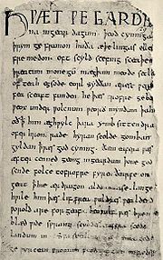
Beowulf

Slide 31
Beowulf
Believed to be written in the 900s.
West Saxon dialect
5” x 8” parchment paper
Bound together with 4 other works in which monsters were a common theme
Now rests in the British Library in London

Slide 32
Epic (a long narrative poem presenting heroic characters who take part in a series of adventures, usually over an extended period of time.
Created as an oral poem-passed down through generations
Would have been performed at mead halls
Beowulf’s character seems to be fictional, but some events do come from history.
Christian elements were added on after it was recorded

Slide 33
Uses caesuras, kennings, alliteration, hyperbole.
Includes anecdotes (short accounts of interesting or entertaining incidents.)
Much of the play is didactic (intended to teach a moral .)

Slide 34
The Plot…
Beowulf travels across the sea to help a kinsman, King Hrothgar, who has been losing warriors for 12 long years to a monster named Grendel . (Grendel needs to be a beast of mythic proportions to make the struggle greater.)
Most of the action takes place in the mead hall which Hrothgar had constructed for merriment and protection.

Slide 35
Characters
Scyld Scefing - Founder of Hrothgar's mighty Danish royal house.
Beowulf the Dane - Not the hero of the poem. A Danish king, son of Scyld Scefing; this Beowulf is sometimes called "Beow".
Healfdene - Danish king; son of Beow the Dane; father of Hrothgar, Heoroga, and Halga.
Hrothgar-Danish king who needs Beowulf’s help with Grendel.
Unferth - Son of Ecglaf; slew his brother; taunts Beowulf early in the poem

Slide 36
Wealhtheow - Hrothgar's queen; mother of Hrethric and Hrothmund.
Ecgtheow - Beowulf's father; married to King Hrethel's only daughter; slays a man and escapes to Denmark. Hrothgar pays his wergild.
Hygelac - Geatish king and uncle to Beowulf. Hygelac is an historical character verified by external evidence.
Geats – tribe that lived in southern Sweden; Beowulf belongs to this tribe.

Slide 37
Let’s read an excerpt from Beowulf and apply what we’ve learned about the Anglo Saxons to the text.
1. Find a partner. In pairs, try to decipher what is happening from lines 1 to 58. Paraphrase (in your own words) these lines.
Hint: It may be easier to break it into the patriarchal lineage of 4 kings:
Scyld
Beow
Haelefdane
Hrothgar
Find the sententia/aphorism/maxim (a brief statement about an important truth.)
Find 4 kennings.

