Slide 1
Good Morning
Wednesday, March 11th, 2020
Today's Schedule:
War Game
Reactivity Lesson
Structures Worksheet
Please put your phone in the phone holder.

Slide 2
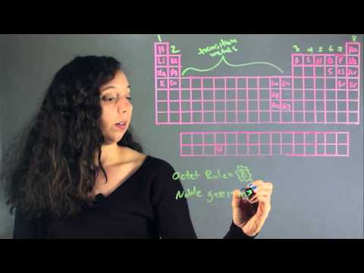
Chemical Reactions

Slide 3
Chemical Reactions
If we know an element’s number of valence electrons, we know HOW and WITH WHAT it will react.
In nature, the only elements that do not react (stable) belong to the last group, or family.
How many valence electrons do elements in family 18 have?
Exception: Helium

Slide 4
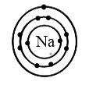
Chemical Reactions
Elements belonging to family 18 do not react with other elements because their outermost electron orbit is considered FULL
All other elements will react in order to FILL their outermost shell of electrons.
Example: If sodium loses an electron, it’s next outermost shell will be full.

Slide 5
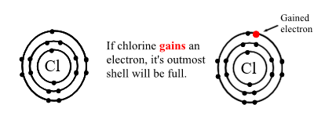
Chemical Reactions

Slide 6
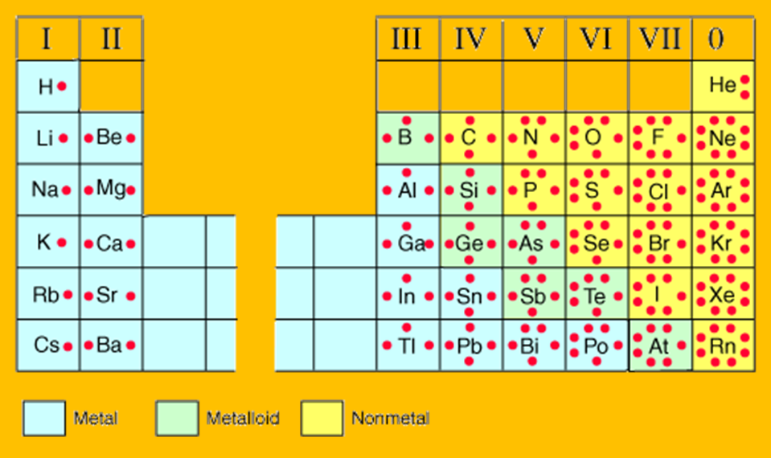
Chemical Reactions

Slide 7
Chemical Reactions
The more electrons in the outermost orbit the more reactive the element is.
Ions always want to fill their outer shell.
SMALLER number means you LOSE valence electrons
BIGGER numbers means you GAIN valence electrons
7 will attract 1
6 will attract 2
5 will attract 3
4 will attract 4

Slide 8
Chemical Reactions
The particles that make up atoms have either a positive or negative charge.
Protons are positive
Electrons are negative

Slide 9
Chemical Reactions
Positive and negative are opposites so they cancel each other out.

Slide 10
Chemical Reactions
In an atom protons are in the center (the nucleus) and electrons are on the outside (the orbits)
Only electrons can be added or taken away.

Slide 11
Chemical Reactions
This atom has 4 protons and 4 electrons.
The positive protons and negative electrons are the same number so this atom is neutral.

Slide 12
Chemical Reactions
What is the charge of this atom?

Slide 13
Chemical Reactions
What is the charge of this atom?

Slide 14
Chemical Reactions
If an atom loses or gains electrons, the number of electrons will no longer be equal to the number of protons.
The atom will now have an overall charge.

Slide 15
Losing an electron
Remember: electrons are negatively charged.
So if a element LOSES an electron, there will now be MORE protons so it will have a POSITIVE charge.
Example:

Slide 16
Gaining an electron
But if the element GAINS electrons then there will be more electrons than protons so the element will have a NEGATIVE charge.

Slide 17
Ions
An atom that has a positive or negative charge is called an ION.
Atoms without a charge (neutral) are called ATOMS

Slide 18
Ions
Only the number of electrons will ever change.
You are always adding or subtracting electrons.
The number of protons will NEVER change, they are trapped in the nucleus of the atom

Slide 19
Chemical Reactions
Practice:
Element | Valence Electrons | Needed for Stability | Charge on Ion
Carbon
Chlorine
Beryllium

Slide 20
Chemical Reactions
Assignment:
Complete the worksheet.
Complete for Homework if not finished in class.

