Slide 1
Good Morning
Monday , February 24th, 2020
Today's Schedule:
Quiz
Periodic Table Lesson
Periodic Table Activity
Please put your phone in the phone holder.

Slide 2
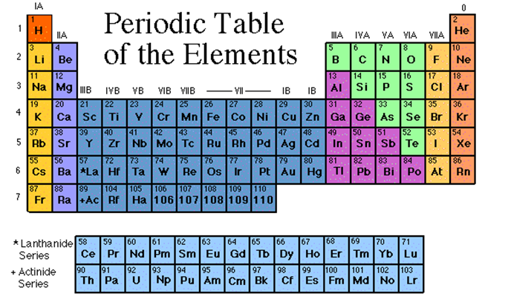
Periodic Table

Slide 3
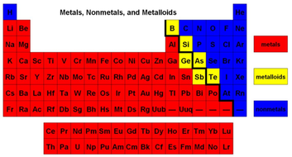
Periodic Table
Colour your Periodic Table to match.

Slide 4
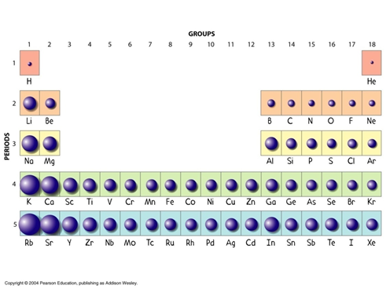
Periodic Table
Atomic Radius:
Sizes of the atoms (atomic radius) generally decrease as we move from left to right across a period.

Slide 5
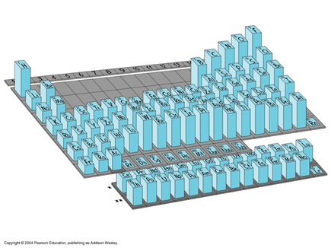
Periodic Table
Electronegativity:
As you move from left to right across a period, the ability of the atom to attract another electron increases

Slide 6
Periodic Table

Slide 7
Periodic Table
Colour your second Periodic Table to match the following slides.

Slide 8
Periodic Table
Hydrogen:
The hydrogen square sits atop Group 1, but it is not a member of that family.
Hydrogen is in a class of its own.
It’s a gas at room temperature
It has one proton and one electron in its one and only orbit.

Slide 9
Periodic Table
Colour hydrogen pink

Slide 10
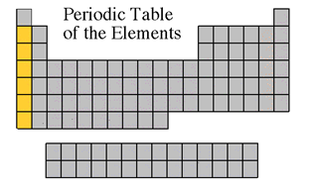
Periodic Table
Alkali Metals:
The alkali family is found in the first column of the periodic table.
Atoms of the alkali metals have a single electron in their outermost orbit, in other words, 1 valence electron.
They are shiny
Have the consistency of clay
Are easily cut with a knife
They are the most reactive metals
They react violently with water
Alkali metals are never found as free
elements

Slide 11
Periodic Table
Colour alkali metals orange

Slide 12
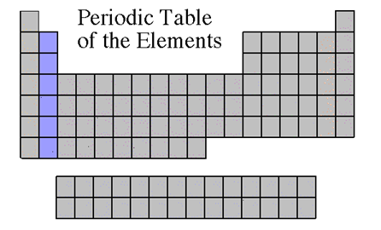
Periodic Table
Alkaline Earth Metals:
They are never found uncombined in nature
They have two valence electrons
Alkaline earth metals include magnesium and calcium among others.

Slide 13
Periodic Table
Colour alkaline earth metals purple

Slide 14
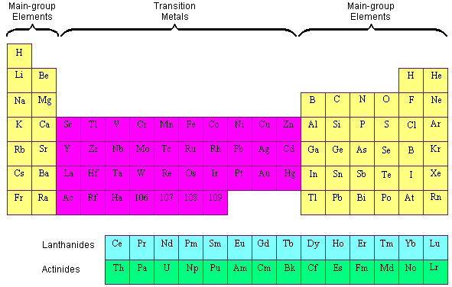
Periodic Table
Colour transition
metals green.

Slide 15
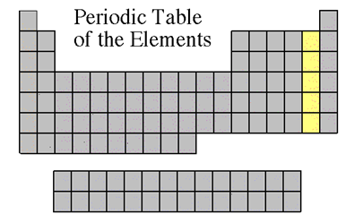
Periodic Table
Halogen Family:
The elements in this family are fluorine, chlorine, bromine, iodine, and astatine.
Halogens have 7 valence electrons
This explains why they are the most active nonmetals
They are never found free in nature.

Slide 16
Periodic Table
Colour halogen family yellow

Slide 17
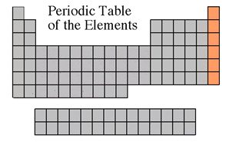
Periodic Table
Noble Gases:
Noble gases are colourless gases that are extremely unreactive because their outermost orbit is full.
They do not readily combine with other elements to form compounds, the noble gases are called inert.
All noble gases are found in small amounts in the earth's atmosphere.

Slide 18
Periodic Table
Colour noble gases red

Slide 19
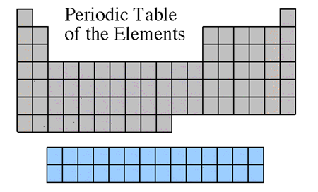
Periodic Table
Rare Earth Elements:
The thirty rare earth elements are composed of the lanthanide and actinide series.

Slide 20
Periodic Table
Colour rare earth elements blue

Slide 21
Periodic Table

