Slide 1
Good Morning
Thursday, February 20th, 2020
Today's Schedule:
WHMIS Lesson
Please put your phone in the phone holder.

Slide 2
WHMIS
Chemical Safety:
Some chemicals are hazardous and can cause harm when not handled properly.
Other chemicals can become harmful when they come in contact with different chemicals.
Chemical safety is important!
Knowing how to properly handle substances can save your skin, your eyesight, and even your life.

Slide 3
WHMIS
WHMIS and International Hazard Symbols:
In order to ensure that everyone can understand the potential dangers of a chemical, a set of internationally standard symbols have been created.
In the scientific community and in many workplaces, the WHMIS symbols are the most common.
Some household products won’t use WHMIS symbols and instead use a simplified International HAzard Symbol System.

Slide 4
WHMIS
W = workplace
H = Hazardous
M = Materials
I = Information
S = System

Slide 5
WHMIS
Symbols are designed to alert workers/students to the hazardous and safe handling procedures for a given product.
In additions to the symbols, the WHMIS label provides First Aid instructions, risk and precautions and a variety of names for the product. (common name, trade name, generic name, brand name) to prevent miscommunication.

Slide 6
WHMIS
*Handout*
These are the 8 symbols:

Slide 7
WHMIS
Your guess

Slide 8
WHMIS
Compressed Gas:
Heating or dropping the container may cause it to explode.
Handle with care - don’t let it drop
Example: oxygen tanks, fire extinguishers

Slide 9
WHMIS
Your guess

Slide 10
WHMIS
Flammable and Combustible material:
Contains material that poses a fire hazard
Do not use near fire or sparks
Some materials may burst into flames when they come in contact with air or water
Examples: pure hydrogen or sodium, fuels, aerosols.

Slide 11
WHMIS
Your guess

Slide 12
WHMIS
Oxidizing materials:
This material may cause a fire hazard when NEAR flammable materials.
It may release oxygen or other substances that will encourage OTHER substances to burn.
May burn skin and eyes on contact.
Keep away from flammable materials and handle using proper safety equipment.
Example: hydrogen peroxide, bleach

Slide 13
WHMIS
Your guess

Slide 14
WHMIS
Poisonous or Infectious materials with immediate toxic effects:
These are immediately dangerous to your life!
Handle these substances with extreme caution using protective equipment.
Avoid contact with skin and eyes!
Avoid inhaling the material or it’s fumes.
Example carbon monoxide, sulfuric acid.

Slide 15
WHMIS
Your guess

Slide 16
WHMIS
Poisonous or Infectious materials causing other toxic effects:
Not immediately harmful.
May cause health issues or death if used repeatedly over a period of time.
May cause irritation of the eyes, skin, and lungs.
Use carefully and with proper safety equipment.
Avoid contact with skin and eyes and avoid inhalation
Example: carcinogens (asbestos), allergens

Slide 17
WHMIS
Your guess

Slide 18
WHMIS
Biohazardous Infectious Materials:
Includes organisms and the materials they produce that can cause infection or disease.
Dispose of materials in a safe designated container.
Don’ handle waste materials with this symbol without proper safety equipment.
Example: viruses or contaminated blood samples.

Slide 19
WHMIS
Your guess

Slide 20
WHMIS
Corrosive Materials:
These materials can “eat: through skin or metals
Always handle with care, clean up using appropriate chemical skill kit and use proper safety equipment at all times!
Example: hydrochloric acid, some household cleaners.

Slide 21
WHMIS
Your guess

Slide 22
WHMIS
Dangerous Reactive Materials:
These products undergo dangerous reactions when exposed to heat, water, pressure or shock.
Store these products carefully and keep them away from any negative factors.
Use carefully and always use proper safety equipment when handling.
Example: ethers and peroxides

Slide 23
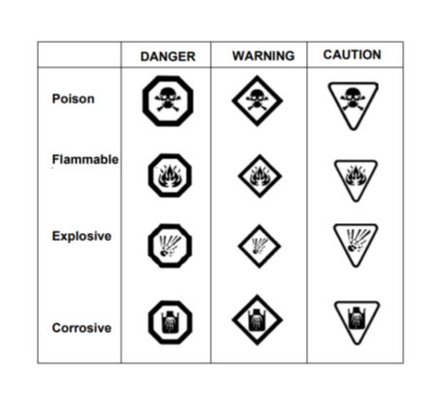
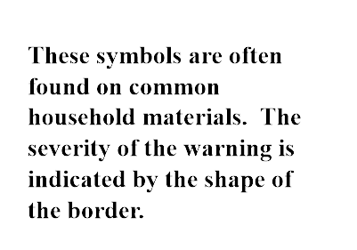
International Hazard Symbols

