Slide 1
Good Afternoon
Today’s Schedule:
What is Media Lesson
Assessing advertisements
Activity
Thursday January 30th, 2020

Slide 2
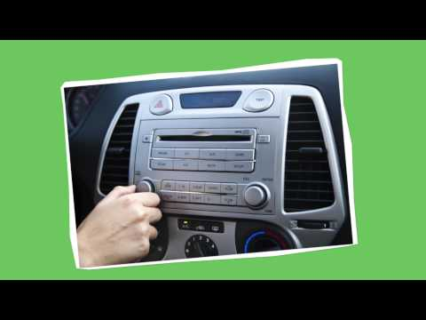
What is Media?

Slide 3
What is Media?
The term media is the plural form of medium.
Medium is a system or channel used for transmitting information, expression or entertainment.
To a communication specialist, television may be the medium of choice. To the sculptor, clay may be the medium of choice.
The key word in this definition is transmit.

Slide 4
What is Media?
Media Influences us every day!
Food videos
Celebrities/Influencers - clothes, music, shows, products
Tv shows - references, activities, places
Media tells us to act a certain way - promoting societal norms

Slide 5
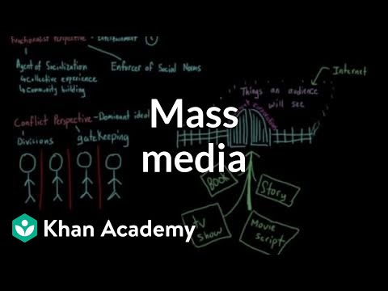
What is Media?

Slide 6
What is Media?
Print Media
Newspaper
Magazines
Books
Brochures
Pamphlet
Flyer

Slide 7
What is Media?
Broadcast Media
Television shows
Television commercials
Radio
Subscription Television (Netflix, Amazon Prime, Apple TV, etc)
Podcasts

Slide 8
What is Media?
Internet Media
Social Media
Websites
Podcasts
Ad Banners
Apps
Sponsorships
Youtube videos
Youtube Ads
Music Videos

Slide 9
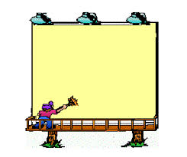
What is Media?
Outside Media
Billboards
Benches
Transit buses
Transit shelters

Slide 10
What is Media?
Other Media
Celebrities/influencers
Video games
Sports
Clothing
Store displays
Art
Music
Performances
Communication - Messaging

Slide 11
What is Media?
Mass media is defined as channels for transmitting or delivering messages and information.
In this course we are focusing on:
The channels that transmit messages and information, particularly mass media
The businesses that deliver news and entertainment through mass media
The businesses that own or control the mass media technology

Slide 12
What is Media?
You spent 11,000 hours in school
15,000 hours watching television or accessing video online.
This does not include:
Texting
Playing video games
Reading
Surfing the internet
Listening to music
Social media

Slide 13
What is Media?

Slide 14
What is Media?
Types of messages in media
Apparent meaning :
What the words, images, sounds that reach the receiver say. Think of the dictionary meaning of the message.
Suggested meaning:
What the sender hopes the message will accomplish. Think of the real reason behind the message.

Slide 15
What is Media?
There are four principles of media:
The media constructs reality
The media have their own forms, codes, and conventions.
The media presents ideologies and values in their messages.
The media are businesses that have commercial interests.

Slide 16
What is Media?
Principle 1: Media constructs reality
Disney World
Instagram picture

Slide 17
What is Media?
Principle 2: The media has their own forms, codes and conventions.
Forms - different ways of communicating in different scenarios
Codes - winking, nodding, smirking - “just kidding”, emoji meanings
Conventions - texting vs emailing
INCREASE EFFECTIVENESS
Ex: music in movies, commercials, tv shows

Slide 18
What is Media?
Principle 3: The media presents ideologies and value messages.
Everyone has their own beliefs and values, and ideologies and they connect us.
We need to consider these when receiving media and acknowledge the views, beliefs, and ideologies that the sender has and is portraying.
This can be done two ways:
Directly: the purpose of the message may be to promote the sender’s values and ideology
Indirectly: When a message is not used to present a belief, view, or ideology but these will influence subconsciously what messages are and are not sent and how they are presented.

Slide 19
What is Media?
Principle 4: The media are businesses that have commercial interests
The relationships between technology, ownership and the creation of mass media messages are so important that when we use the term "the media," we are usually referring to all three.
Creating and distributing mass media messages can be an expensive, and potentially profitable
Big business and corporations are usually involved in the creation and distribution of mass media messages

Slide 20
What is Media?
Important Questions to consider when viewing media:
How is the topic presented?
What themes are being used?
What are other ways in which this topic could be presented?
What has been included and what has been omitted?
Whose voices and positions are being expressed?
Whose voices and positions are not being expressed?
What is the text trying to do to the reader/listener/viewer? How does it do it?
What other ways are there to convey this message?
Who constructed this text? (age, gender,race,nationality)
What are the writer's/producers views/beliefs?
From whom is the text constructed?
Where did it appear?
For what purpose could the text be used?
What does the text tell us that we already know?
What does the text tell us that we don’t already know?
What is the topic?

Slide 21
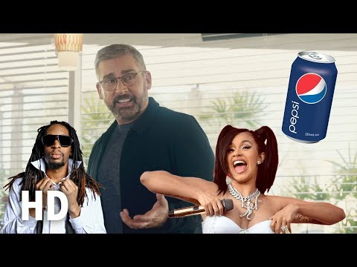
What is Media?

Slide 22
What is Media?
What are the writer’s/producer’s beliefs?
For who was this constructed?
Where did it appear?
What voices and opinions are being expressed?
What voices and opinions are not being expressed?
What is the commercial trying to do to the viewer?
Apparent
Suggested

Slide 23
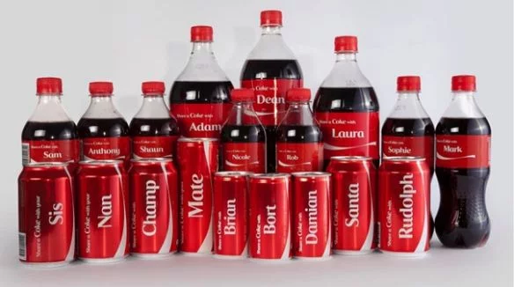
What is Media?

Slide 24
What is Media?
What are the writer’s/producer’s beliefs?
For who was this constructed?
Where did it appear?
What voices and opinions are being expressed?
What voices and opinions are not being expressed?
What is the advertisement trying to do to the viewer?
Apparent
Suggested

Slide 25
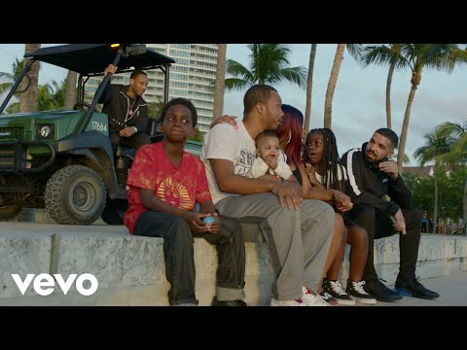
What is Media?

Slide 26
What is Media?
What are the writer’s/producer’s beliefs?
For who was this constructed?
Where did it appear?
What voices and opinions are being expressed?
What voices and opinions are not being expressed?
What is the video trying to do to the viewer?
Apparent
Suggested

Slide 27
What is Media?

Slide 28
What is Media?
What are the writer’s/producer’s beliefs?
For who was this constructed?
Where did it appear?
What voices and opinions are being expressed?
What voices and opinions are not being expressed?
What is the video trying to do to the viewer?
Apparent
Suggested

Slide 29
What is Media?
Activity:
Advantages and Disadvantage of types of media

Slide 30
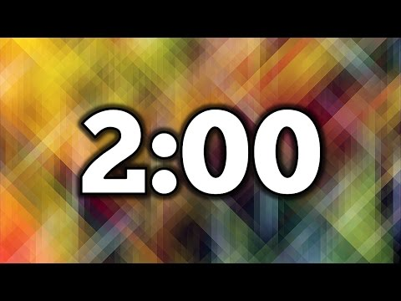
What is Media?

Slide 31
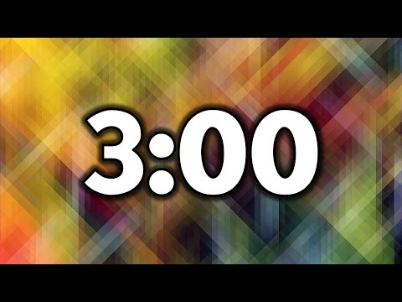
What is Media?

