Slide 1
Good Afternoon
Friday February 21st, 2020
Today’s Schedule:
Hand Back Tests - Go over them
Review Game
Journal Entry
PLEASE PUT YOUR PHONE IN THE PHONE HOLDER

Slide 2
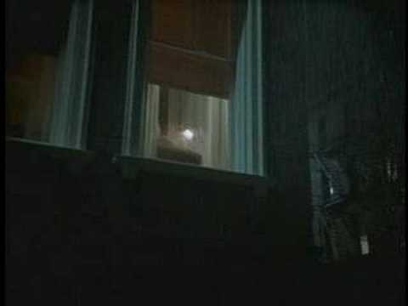
Journal Video #1

Slide 3
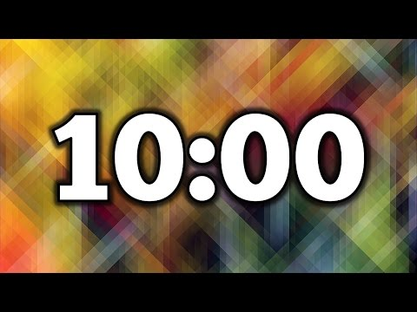
Journal Entry
Complete Journal Entry Part 1

Slide 4
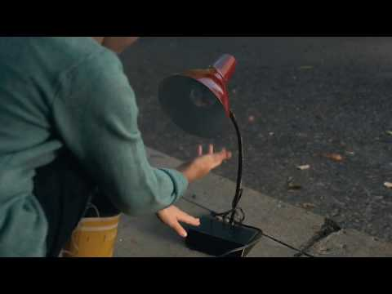
Journal Video #2

Slide 5
Journal Entry
Complete Journal Entry Part 1

