Slide 1
© Presto Plans

Slide 2
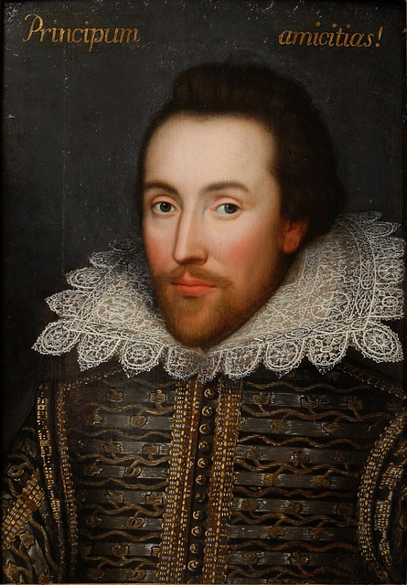
CONSTRUCTION
The Globe theatre was originally built in 1598 and opened it's doors to the public in 1599.
The theatre was built because The Lord Chamberlain’s Men (Shakespeare’s acting troupe) needed a place to perform their plays so they could compete with other acting troupes.
© Presto Plans
© Presto Plans

Slide 3
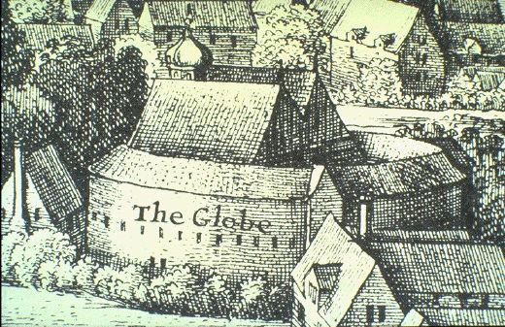
THE THEATRE
Shakespeare's Globe was the most popular English theatre of its time, frequented by people from all walks of Elizabethan life.
From 1599 until 1640 the audiences at the Globe consisted of people from a variety of social and cultural backgrounds. Peasants, prostitutes, merchants, laborers, wealthy citizens, and lords and ladies frequented the playhouses of Shakespeare’s London.
© Presto Plans
© Presto Plans

Slide 4
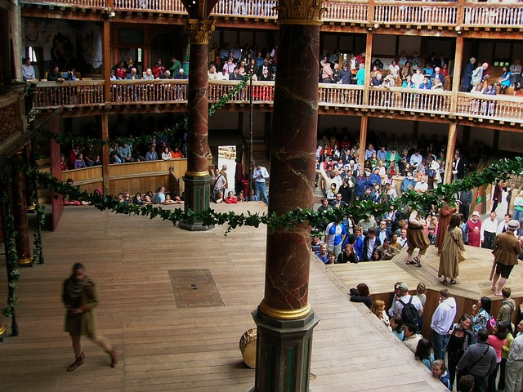
THE FLOOR
The poor spectators, known as Groundlings, could attend plays for very little money, but they had to stand. It would be difficult to see from this location unless you were directly beside the stage. Plays often lasted 4-6 hours, and the Groundlings were forced to stand for the entire play!
© Presto Plans
© Presto Plans

Slide 5
SECOND LEVEL
The middle to upper class spectators could afford to be on the second level. This section wrapped around both sides of the stage and had seating.
© Presto Plans
© Presto Plans

Slide 6
THIRD LEVEL
Only the upper class could afford seats on the third level. For extra money they could even get a padded seat.
© Presto Plans
© Presto Plans

Slide 7
THE STAGE
The actors on stage had to deal with distractions like weather (there was no roof), a rowdy audience, and even having food thrown at them if the performance was bad!
© Presto Plans
© Presto Plans

Slide 8
TIRING HOUSE
The 'tiring house’ was the area back stage. This is where costumes and props were stored, and where actors got ready for performances.
© Presto Plans
© Presto Plans

Slide 9
HELL
The stage had a trapdoor that would lead to an area under the stage, known sometimes as hell or the underworld at the Globe.
© Presto Plans
© Presto Plans

Slide 10
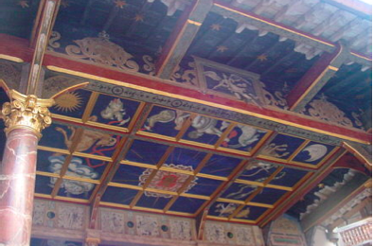
HEAVEN
Large columns on either side of the stage supported a roof over the rear portion of the stage. The ceiling under this roof was called the "heavens," and was painted with clouds and the sky. A trap door in the heavens enabled performers to descend using some form of rope or harness.
© Presto Plans
© Presto Plans

Slide 11
PROBLEMS
Some of the day-to-day problems faced by The Globe Theatre included:
- Fights
- Disease (the plague)
- Drug dealing
- Prostitution
- Theft
© Presto Plans
© Presto Plans

Slide 12
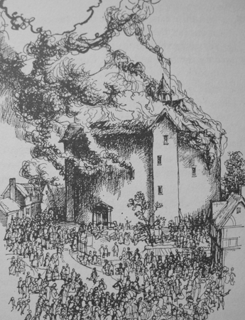
TRAGEDY STRIKES
The Globe burned down in 1613 from a cannon blast during the play “Henry VIII”. It was rebuilt and reopened in 1614.
The theatre was also closed down by the Puritans in 1642 and was torn down in 1644.
© Presto Plans
© Presto Plans

Slide 13
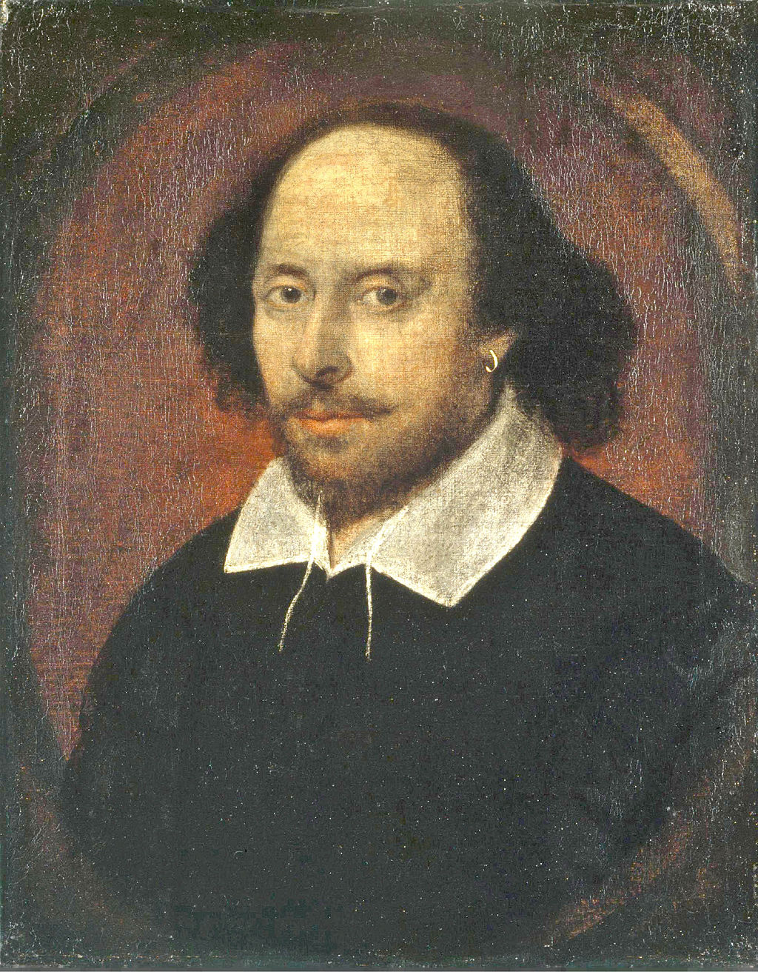
RECONSTRUCTION
In 1949, Sam Wanamaker came to London searching for the site of the original Globe and was disappointed not to find a more lasting memorial to Shakespeare. As a result, in 1970 he founded the Shakespeare Globe Trust.
© Presto Plans
© Presto Plans

Slide 14
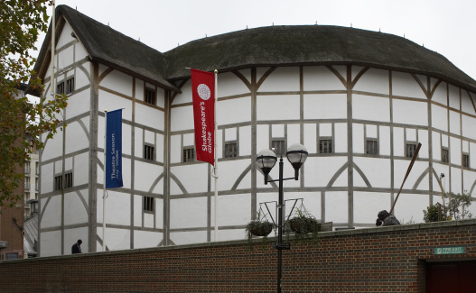
RECONSTRUCTION
In 1987, building work began on the site, and in 1993, the reconstruction of the Globe theatre itself began!
© Presto Plans
© Presto Plans

Slide 15
FUN FACTS
DID YOU KNOW?
The original Globe held about 3000 people!
Although most of Shakespeare’s plays were held there, he only owned 12% of the theatre.
© Presto Plans
© Presto Plans

Slide 16
FUN FACTS
DID YOU KNOW?
The theatre had no roof, so plays had to be held during the day for lighting.
People often skipped work to go to the plays.
© Presto Plans
© Presto Plans

Slide 17
FUN FACTS
DID YOU KNOW?
During Shakespeare’s lifetime, there were laws forbidding people from wearing clothes better than their social rank, making it easy to identify the social status of people on the streets. So, if an actor who played a king wore his costume outside of the playhouse, he could be prosecuted.
© Presto Plans
© Presto Plans

Slide 18
VIRTUAL TOUR
Click on the image below to take a tour of Shakespeare's Famous theatre!
http://www.shakespearesglobe.com/about-us/virtual-tour
© Presto Plans
© Presto Plans

