Slide 1
I can explain the variation in physical landscape across canada

Slide 2
What are landforms
Landforms are the topography, or the natural features, of the land’s surface.

Slide 3
A landscape is an area’s is an area’s landforms together with its cover of vegetation, water, ice, and rock.

Slide 4
Landscape can have a direct effect on peoples lives, influencing what they eat, how they earn a living, who they do business with, and many other factors of daily life.

Slide 5
How are landforms built?
The earth’s surface is built of material that comes from beneath the crust, or it is formed by the movement of the crust itself.

Slide 6
How are landforms shaped?
Canada’s topography is the result of four forces:
The building-up forces of mountain building.
The wearing-down forces of weathering, or exposure to the atmosphere.

Slide 7
The wearing-down forces of erosion.
The building-up forces of deposition, where eroded materials add new shapes.

Slide 8
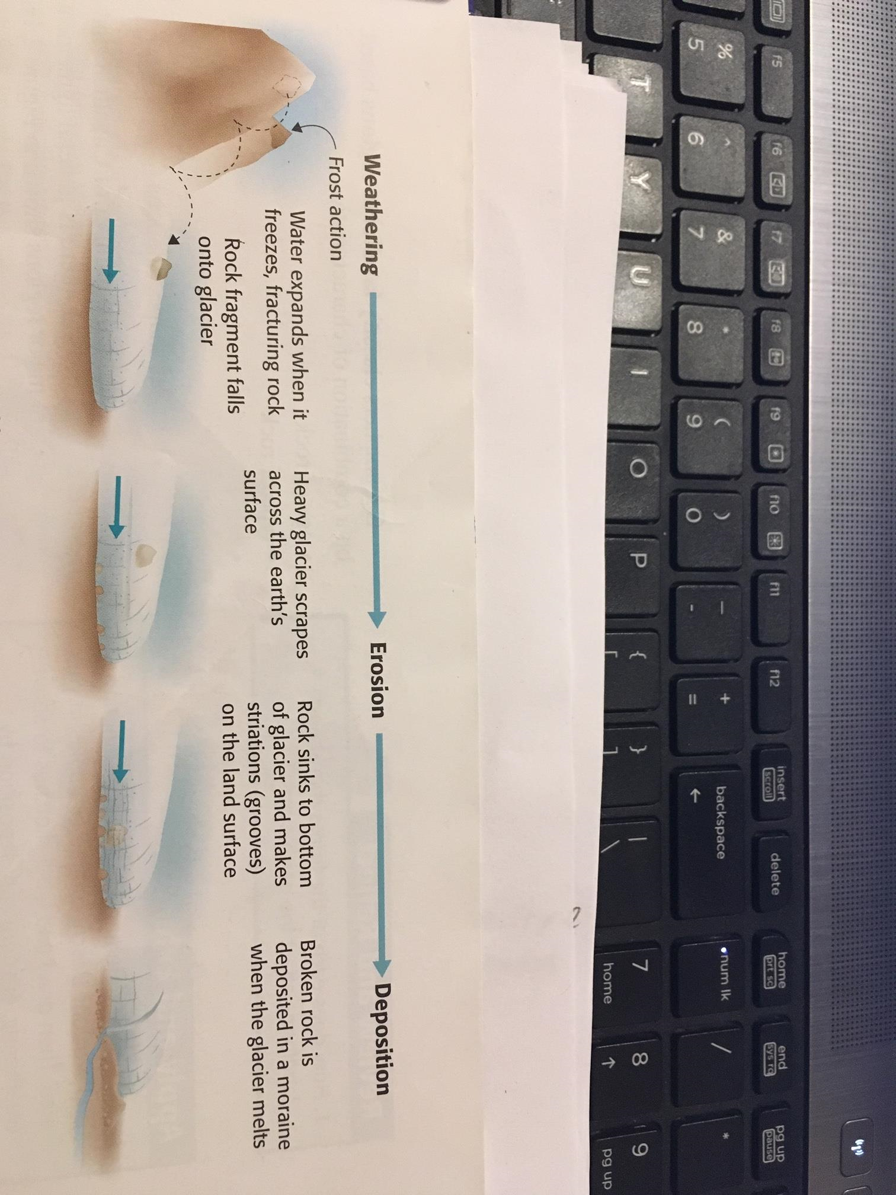

Slide 9
Weathering is the gradual breaking down of solid rock by exposure to air, water, animals, and plants.

Slide 10
Erosion is the process by which the land surface is sculpted and weathered particles are carried away, by running water, tides, wind, and glaciers.

Slide 11
Deposition is the depositing of the weathered particles as sediment by agents of erosion.

Slide 12
After long periods of time, the sediment may combine to form sedimentary rock. This rock can eventually rise to form new mountains or areas of plains or plateaus.

Slide 13
Plateaus and plains may appear similar because they are relatively flat areas. However, the term “plateau” describes an area between mountains. It has formed as a result of movements of the earth’s crust.

Slide 14
A plain is land that formed under a lake or a sea. It was exposed when the water receded.

