Slide 1
RESTITUTION IN
CANADA

Slide 2
“After some 500 years of a relationship that has swung from partnership to domination, from mutual respect and co-operation to paternalism and attempted assimilation, Canada must now work out fair and lasting terms of coexistence with Aboriginal people.”
- Royal Commission on Aboriginal People, 1996
Indigenous Peoples receiving treaty money ( 1930)
Notes:
Indigenous Peoples receiving treaty money, 1930. (Courtesy Library and Archives Canada/MIKAN 3348407)

Slide 3
WHAT IS RESTITUTION?
‘The act of returning something that was lost or stolen to its owner’
‘Making good of or giving an equivalent for some injury’
‘A legal action serving to cause restoration of a previous state’
-Webster’s Dictionary
Treaty No. 5, Saskatchewan, North-West Territory. Plan showing addition to the Grand Rapids Reserve.
Notes:
Treaty No. 5, Saskatchewan, North-West Territory. Plan showing addition to the Grand Rapids Reserve. (courtesy Library and Archives Canada/ MIKAN 4139475)

Slide 4
RESTITUTION IS ABOUT MAKING IT RIGHT
ACTING ON RECONCILIATION THROUGH ACTION
Notes:
Photos: 1. People express their emotions during the Truth and Reconciliation Commission of Canada's regional event at the Victoria Conference Centre in Victoria, B.C., Friday April 13, 2012. THE CANADIAN PRESS IMAGES/Chad Hipolito
2. Toronto Mayor John Tory hold an indigenous child from the northern community of Kitchenuhmaykoosib Inninuwug First Nation (courtesy of Productions Cazabon)
3. Female drummer sings a traditional song during the Sacred Walk Protest (courtesy of Productions Cazabon)

Slide 5
1
RESTITUTION IN CANADA
RESOVLING THE LAND ISSUE
Treaty No.9 Commission, Commissioners land and Long Lake, ON.( 1906)
Notes:
Treaty No.9 Commission, Commissioners land and Long Lake, ON. 1906. (From the Archives of Matawa First Nations)

Slide 6
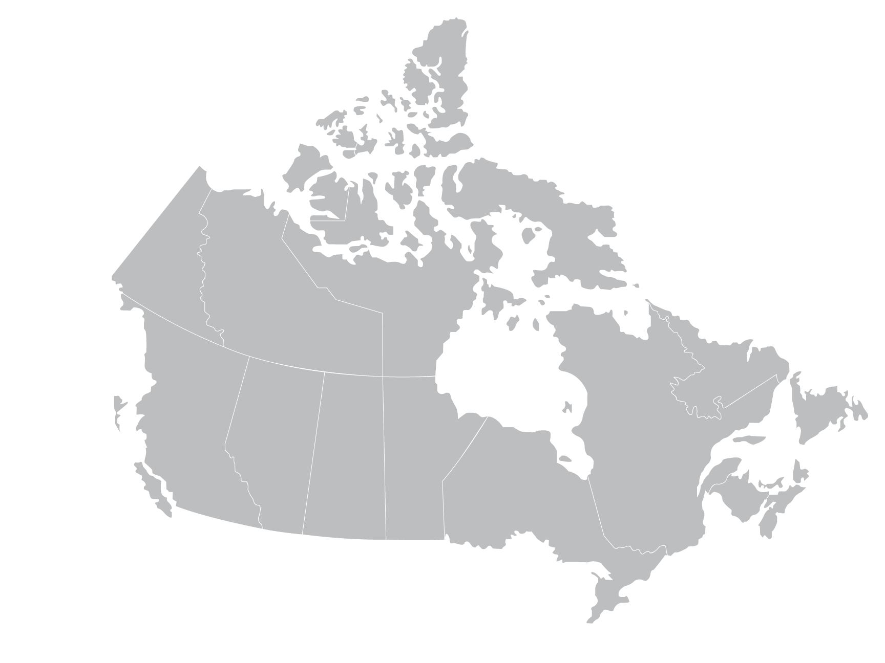
RESTITUITION
CANADA’S MAP NOW
.
99%
1%
Treaties were created with the intention to share the land equitably. Canada now controls nearly 99% of the land while Indigenous people own less than 1%.
What would a fair map look like?

Slide 7
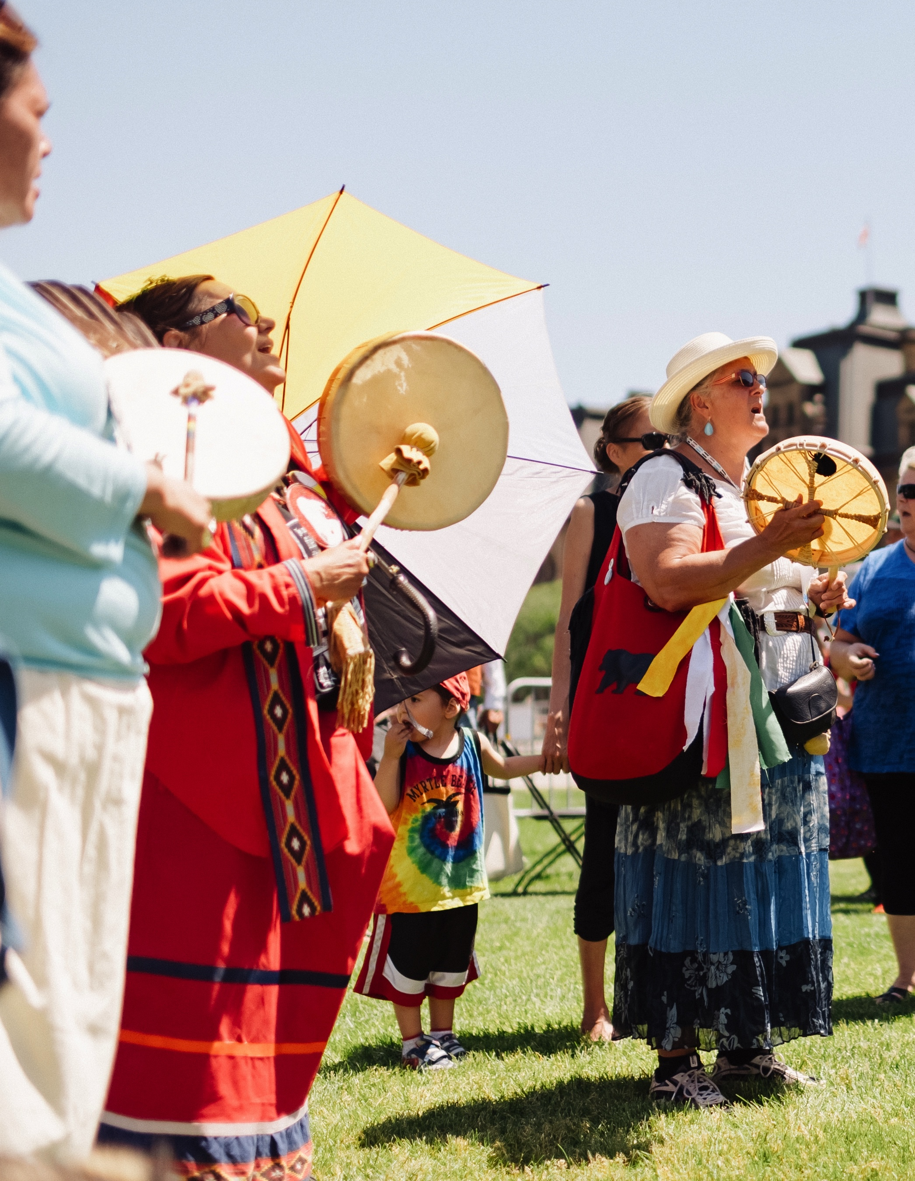
Lee Maracle
INDIGENOUS WRITER
“We have a large problem in Canada: we’re still colonized. And restitution has to be made for that. The beginnings of restitutions is, of course, having indigenous people negotiating with Canada for a fair and equitable sharing of the country.”
A group of Indigeous Women form a drum circle (2015)
Notes:
Photo: A group of Indigeous Women form a drum circle (courtesy productions cazabon)

Slide 8
2
RESTITUTION IN CANADA
REPARING THE DAMAGE OF RESIDENTIAL SCHOOLS
A group of female students and a nun pose in a classroom at Cross Lake Indian Residential School in Cross Lake, Man.(1940)
Notes:
A group of female students and a nun pose in a classroom at Cross Lake Indian Residential School in Cross Lake, Man. February 1940. (Library and Archives Canada/Reuters)

Slide 9
RESTITUTION IN CANADA
ACTING ON THE 94 CALLS TO ACTION
3
Commission chairman Justice Murray Sinclair (centre) and fellow commissioners discuss the TRC’s report on Canada’s residential school system (2015)
Notes:
Photo: Commission chairman Justice Murray Sinclair (centre) and fellow commissioners Marie Wilson (right) and Wilton Littlechild discuss the commission's report on Canada’s residential school system at the Truth and Reconciliation Commission in Ottawa on Tuesday, June 2, 2015. THE CANADIAN PRESS/Adrian Wyld

Slide 10
4
RESTITUTION IN CANADA
ADOPTING THE UN DECLARATION
ON THE RIGHTS OF
INDIGENOUS PEOPLE
Notes:
Photo: Flags of the World (open source)

Slide 11
A bedroom in the the remote fly in community of Kitchenuhmaykoosib Inninuwug First Nation (2017).
5
RESTITUTION IN CANADA
CLOSING THE GAP IN LIVING CONDITIONS
Notes:
Home in the the remote fly in community of Kitchenuhmaykoosib Inninuwug first Nation. (Photo courtesy of Productions Cazabon)

Slide 12
CLOSING THE GAP
DRINKING WATER
EDUCATION
CHILD WELFARE
HEALTH
HOUSING
Notes:
Photos: open source

Slide 13
Toronto, ON
CANADA IS #2
For the second year in a row Canada has been named the 2nd best country in the world, and 1st in Quality of Life.
FIRST NATIONS #63
In comparison First Nations reserves rank 63rd and lower, due to poor living conditions.
Indigenous children play in a water- filled ditch in the First Nations reserve in Attawapiskat, Ont. (2016)
Notes:
Photol: 1. Toronto, ON. (public domain) 2. Indigenous children play in a water- filled ditch in the northern Ontario First Nations reserve in Attawapiskat, Ont., on Tuesday, April 19, 2016.THE CANADIAN PRESS/Nathan Denette

Slide 14
Dancers in regalia at the First Nation University Pow Wow (2017)
6
RESTITUTION IN CANADA
ENDING COLONIALISM & FORCED ASSIMILATION
Notes:
First Nation University Pow Wow, 2017 (Courtesy Productions Cazabon)

Slide 15
“Canadians need to understand that Aboriginal peoples are nations.”
-Royal Commission on Aboriginal People

Slide 16
“That is, they are political and cultural groups with values and lifeways distinct from those of other Canadians. They lived as nations for thousands of years before the arrival of Europeans. As nations, they forged trade and military alliances among themselves and with the new arrivals. To this day, Aboriginal people's sense of confidence and well-being as individuals remains tied to the strength of their nations. Only as members of restored nations can they reach their potential in the twenty-first century.”
-Royal Commission on Aboriginal People
Notes:
Photo: a line of tipis at sunset (courtesy of Productions Cazabon)

Slide 17
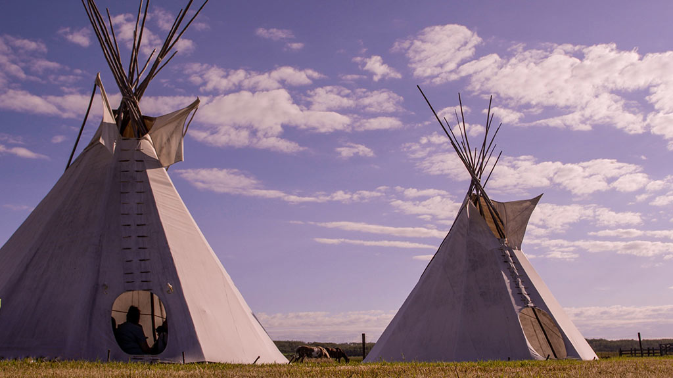
FULL
RESTITUTION ULTIMATELY MEANS:
Respecting that Indigenous People have the right to self-determination. They too are Nations on this land.
Notes:
Photo: Residential school survivor Lorna Standingready is comforted by a fellow survivor in the audience during the closing ceremony of the Indian Residential Schools Truth and Reconciliation Commission, at Rideau Hall in Ottawa on Wednesday, June 3, 2015. THE CANADIAN PRESS/Sean Kilpatrick

