Slide 1
STUDENT RECONCILIATION
MOVEMENTS
Notes:
Photo: open source

Slide 2
IDENTIFY
CONTINUITY &
CHANGE
We sometimes misunderstand history as a list of events. Once we start to understand history as a complex mix of continuity and change, we reach a fundamentally different sense of the past.
There were lots of things going on at any one time in the past. Some changed rapidly while others remained relatively continuous. The decade of the 1910s in Canada, for instance, saw profound change in many aspects of life, but not much change in its forms of government. If we say, “nothing happened in 1911” we are thinking of the past as a list of events.
Notes:
The 6 Thinking Hats of Historical Thinking

Slide 3
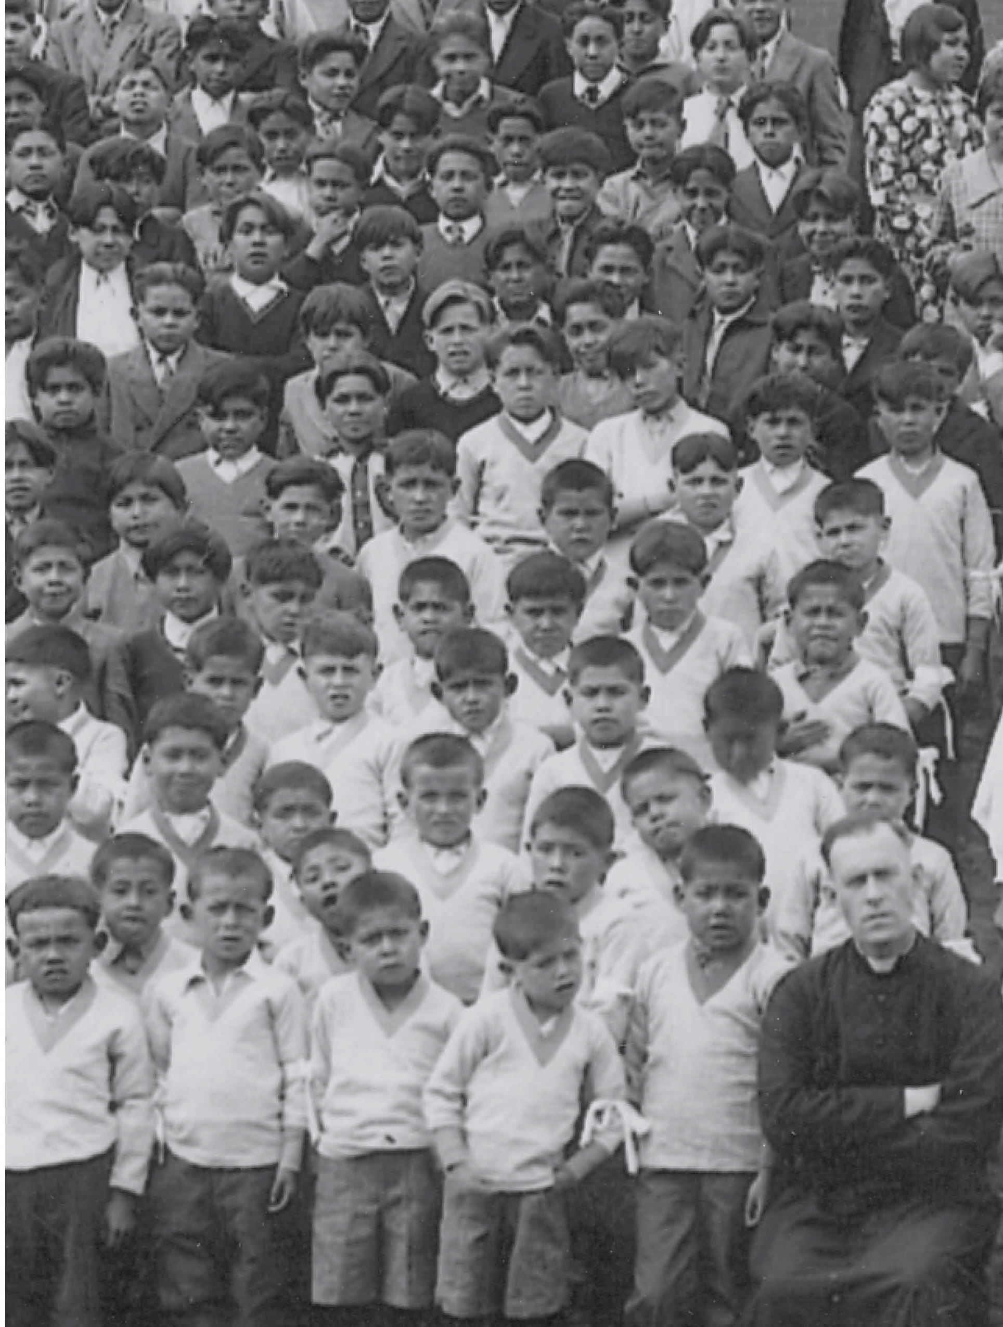
JUSTICE MURRAY SINCLAIR
TRC Commissioner
“Reconciliation turns on this concept: I want to be your friend and I want you to be my mine. And if we are friends then I will have your back when you need it and you’ll have mine.”
Students and staff assemble for a group photo in front of the Kamploops Residential school, British Columbia (1934)
Notes:
Background photo: Students and staff assemble for a group photo in front of the Kamploops Residential school, British Columbia, 1934. (Deschâtelets Archives)

Slide 4
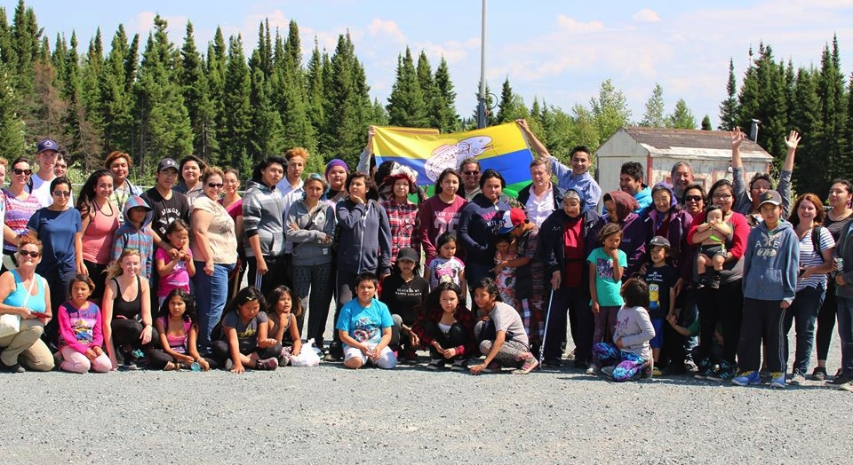
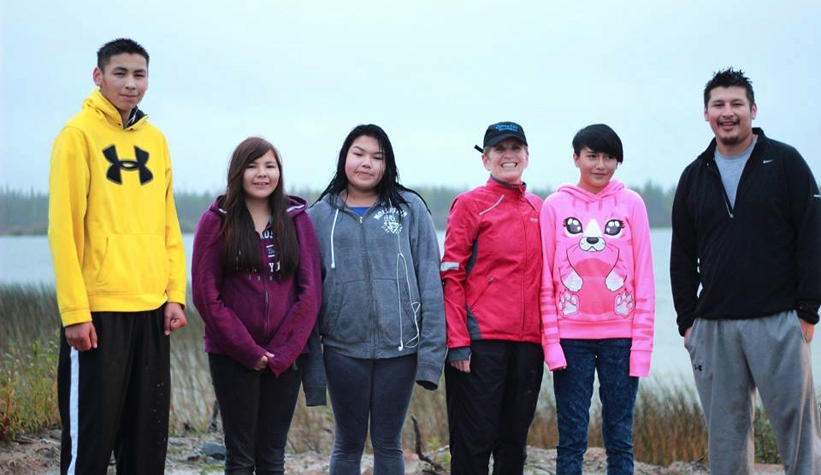
STUDENT RECONCILIATION MOVEMENTS
Reconciliation
The Community of KI gather with Reconciliation Trip Volunteers (2016)
There are many different ways that young people in Canada are taking action to work towards reconciliation.
For example, the youth from the community in the film 3rd World Canada now host reconciliation trips in their homes.
KI youth with Premier Kathleen Wynne (2015)
Notes:
Photo: (courtesy Productions Cazabon)
1. KI youth with Premier Kathleen Wynne
2. The Community of KI gather with Reconciliation Trip Volunteers for a group photo

Slide 5
STUDENT RECONCILIATION MOVEMENTS
SHANNEN’S DREAM
Shannen Koostachin was a 13 year old youth from Attawapiskat First Nation in northern Ontario, a community that for years did not have a proper school.
The youth in her community desperately needed a real school.
Shannen’s dream was a campaign to have safe and comfy schools and culturally based education for First Nations children and youth. She worked hard to convince the federal government that all First Nations children deserve a proper education.
Shannen, tragically died in a car accident in 2012 while she was living in Thunder Bay attending high school.
Shannen Koostachin dancing at a Timiskaming District Secondary powwow
Notes:
photo: Shannen Koostachin is seen above dancing at a Timiskaming District Secondary powwow. (CP/HO- Charlie Angus, MP, Timmins - James Bay)

Slide 6
STUDENT RECONCILIATION MOVEMENTS
SHANNEN’S DREAM
Shannen was a huge inspiration to other First Nations and non First Nations youth across the country, who still work towards Shannen’s Dream. You too can get involved in this campaign.
The National Film Board produced a film by director Alanis Obomsawin about the community of Attawapiskat and the youth’s determination to have a safe and comfy school.
Watch Film Trailer for ‘Hi-Ho Mistahey!’: https://www.youtube.com/watch?v=h9v9qHXmM2k
A new school was finally completed and opened in Attawapiskat in 2014.
Chelsea Edwards, friend of the late Shannen Koostachin, and Shannen’s father take part in a press conference on Parliament Hill in Ottawa (2012)
Notes:
VIEW THE TED TALK About Shannen’s dream: https://www.youtube.com/watch?v=e4BFRSIcUi0&t=159s
Photo: Chelsea Edwards, friend of the late Shannen Koostachin, left, and Shannen’s father Andrew take part in a press conference on Parliament Hill in Ottawa on Monday, February 27, 2012., regarding the New Democratic Party motion "Shannen's Dream." THE CANADIAN PRESS/Sean Kilpatrick

Slide 7
ONTARIO YOUTH CALL FOR
MANDATORY INDIGENOUS STUDIES
Students Ticarra Paquet and Starr Trudeau started a petition calling for mandatory indigenous studies courses to be taught in all Ontario Elementary Schools.
This petition has gained support and the attention of several news sources.You can find and sign the petition at: https://www.change.org/p/mandatory-indigenous-studies-course
Taking Indigenous Studies in your school is an important part of taking action towards Reconciliation. By taking this course, you are part of the change that Ticarra and Starr hoped for!
Starr Trudeau and TiCarra Paquet
Notes:
Watch them talk about their work: here
https://www.youtube.com/watch?v=D_zTuHuFsTM
Photo: Pictured are Starr Trudeau and TiCarra Paquet who helped coordinate the discussion about residential schools for Marymount Academy. (Courtesy Sudbury Catholic Schools)

Slide 8
STUDENT RECONCILIATION MOVEMENTS
YOUNG FASHION DESIGNERS
Using fashion to decolonize the lens of history: Jared Yazzie (Navajo) founder of OXDX Clothing started in a college dorm room. Most of his work is made to show the real face of history and our currents reality towards the First Peoples.
OxDx takes a critical look at Manifest Destiny - the belief of American expansion. Even if that expansion involved genocide, colonization, and assimilation to a population of people already settled to the land.
Jared Yazzie founder of OXDX Clothing
Notes:
Photo top: OXDX Clothing ‘Native Americans Discovered Columbus Women's Tank’ from: http://oxdx.storenvy.com/
Photo bottom: Jared Yazzie founder of OXDX Clothing (OXDX Clothing.com)

Slide 9
STUDENT RECONCILIATION MOVEMENTS
HAVE A HEART DAY
Each year in February, the Caring society invites groups of children and their teachers to gather at Parliament Hill in Ottawa for “Have a Heart Day”.
With hand-made signs and speeches, the children ask The government of Canada to “Have a Heart” for First Nations children.
They fight for the right to equal funding for education, child welfare and health care towards First Nations children.
Notes:
Photos: Have a heart day 2015 (coutesy of First Nations Child & Family Caring Society of Canada)

Slide 10
STUDENT RECONCILIATION MOVEMENTS
WHAT YOU CAN DO?
Youth Holding the 1764 Treaty Belt in front of the Parliament Buildings (2015)
Notes:
Photo: Youth Holding Wampum Treaty Belt (courtesy of Productions Cazabon)

Slide 11
Indigenous dancers rally during an 'Idle No More' gathering on Parliament Hill in Ottawa (2013)
STUDENT RECONCILIATION MOVEMENTS
WHAT CAN YOU DO?
As a youth, there are many ways that you can work towards reconciliation. Learning about these issues in school is a great start!
The First Nations Child and Family Caring Society has many child and youth oriented campaigns that you can join today!
Their website lists “7 Free Ways to Make Difference” which includes more information about Shannen’s Dream for Safe and Comfy schools, and more!
Notes:
More info here: http://www.fncaringsociety.com/7-free-ways-make-difference
Photo: Native dancers rally during an 'Idle No More' gathering on Parliament Hill in Ottawa on Monday, Jan. 28, 2013. THE CANADIAN PRESS/Sean Kilpatrick

