Slide 1
WAMPUM BELT
TEACHINGS
Notes:
Photo: open source

Slide 2
WAMPUM BELT TEACHINGS
THE TWO ROW WAMPUM
One of the oldest treaty relationships between the Onkwehonweh (original people) of Turtle Island (North America) and European immigrants.
The Treaty was made in 1613: between the Dutch and the Haudenosaunee (Iroquois) as Dutch traders and settlers moved up the Hudson River into Kanien’kehá:ka (Mohawk) territory.
The Dutch initially Proposed a patriarchal relationship with themselves as fathers and the Haudenosaunee people as children.
Champlain Trading with the Indians’(1911)
by Charles William Jefferys
Notes:
Photo: ‘Champlain Trading with the Indians’ 1911 by Charles William Jefferys (Library and Archives Canada C-103059)

Slide 3
WAMPUM BELT TEACHINGS
OUR OWN WAYS
The Haudenosaunee rejected this notion and instead proposed:
One, a birchbark canoe, will be for the Indian People, their laws, their customs, and their ways.
The other, a ship, will be for the white people and their laws, their customs, and their ways.
Indigenous peoples were intent on maintaining their own ways of life.
Goldie Jamison Conklin, a Seneca of the Heron (1912)
Notes:
Photo: An old postcard for the Cattaraugus Cutlery Company features Goldie Jamison Conklin, a Seneca of the Heron Clan, from the Allegany Reservation, in Western New York. Dated 1912.

Slide 4
“We will not be like father and son but like brothers. Our treaties symbolize two paths or two vessels, travelling down the same river together.”
-The Haudenosaunee, 1613
Notes:
Photo: Two Indigenous youth stand in protest (courtesy productions cazabon)

Slide 5
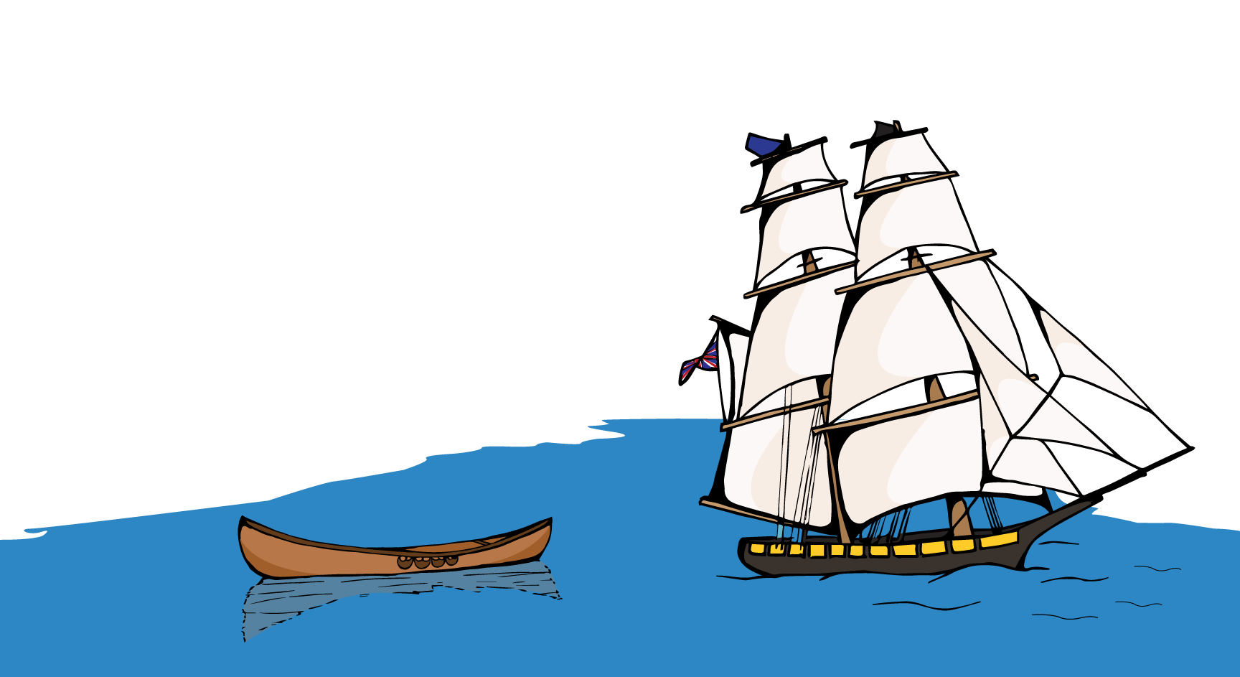
“We shall each travel the river together side by side, but in our own boat. Neither of us will make compulsory laws nor interfere in the internal affairs of the other. Neither of us will try to steer the other’s vessel.”
-The Haudenosaunee, 1613
Notes:
Illustration of a European tall ship and an Indgenous canoe sailling down the same river (Courtesy of Productions Cazabon)

Slide 6
The two row wampum belt
THE AGREEMENT
Well aware of the political and military strength of the Haudenosaunee Confederacy (which included the Kanien’kehá:ka), the Dutch agreed with the principles of the Two Row.
As was their custom for recording events of significance, the Haudenosaunee created a wampum belt out of purple and white quahog shells to commemorate the agreement.
Notes:
Photo: Two Row Wampum Belt (Productions Cazabon)

Slide 7
Quahog beads are strung together then woven into belts.
WAMPUM BELT TEACHINGS
WAMPUM BELT DESIGN & MEANING
The belt consists of two rows of purple wampum beads on a white background. The three rows of white beads which separate the two purple rows symbolize peace, friendship, and respect.
Wampum beads are made from quahog shells
TWO ROWS, TWO PATHS
The two purple rows symbolize two paths or two vessels travelling down the same river.
One row symbolizes the Indigenous people with their laws and customs, while the other row symbolizes the Europeans with their laws and customs.
Notes:
Photos: courtesy of Productions Cazabon
1. A string of quahog shell beads are hand carved and strung up to create a wampum belt
2. A quahog shell are collected and bead are carved out

Slide 8
WAMPUM BELT TEACHINGS
THE PRINCIPLES OF
TWO ROWS
As nations move together side-by-side on the River of Life, they are to avoid overlapping or interfering with one another.
The principles of the two rows were consistently
restated by Haudenosaunee spokespeople and were extended to relationships with the French, British, and Americans under the framework of the Silver Covenant Chain agreements.
The two row wampum belt
Notes:
Photo: Close up of Two Row Wampum Belts (Productions Cazabon)

Slide 9
THE TWO ROWS AGREEMENT IS FOREVER
It was understood by the Haudenosaunee that the Two Row agreement would last forever, that is, “as long as the grass is green, as long as the water flows downhill, and as long as the sun rises in the east and sets in the west.”
Notes:
Photo: close up of Wampum belt (Courtesy of Productions Cazabon)

Slide 10
The two row wampum belt
WAMPUM BELT TEACHINGS
THE TWO ROWS AS A FRAMEWORK
The two rows can function as a framework for decolonization & reconciliation. Since holding true to the Two Row means supporting the right of Indigenous people to maintain themselves on their own land according to their own systems of self-governance, organization, and economics.
Notes:
Photo close up of treaty belt: (courtesy of Productions Cazabon)

Slide 11
WAMPUM BELT TEACHINGS
THE TWO ROW WAMPUM REMAINS
The Two Row Wampum remains a treaty relationship that Haudenosaunee and other Indigenous nations defend today, even if the Canadian state has failed to uphold the principles of the treaties it inherited from the British Crown.
The British Crown and the colonial Canadian State have been unwilling to respect the self-determination of Indigenous peoples or to uphold the Two Row Wampum. Still, non-Indigenous people can learn this history and inform others about the original framework based on genuine peace, respect, and friendship with Indigenous peoples.
The two row wampum belt
Notes:
Photo: Two Row Wampum Belt (Courtesy Productions Cazabon)

Slide 12
WAMPUM BELT TEACHINGS
REDEFINING THE RELATIONSHIP
With the rise of a new cycle of Indigenous struggles, and with the global crisis of capitalism intensifying, the recent 400th anniversary of the Two Row Wampum is a good moment for us to start redefining the relationship between Indigenous and non-Indigenous peoples.
Notes:
Photo:
1.Youth hold 1784 treaty Belt on Parliament Hill (Productions Cazabon)
2. Activists engage in a peaceful march towards Parliament hill (Productions Cazabon)
3. Drum group in front of Parliament Hill 9Productions Cazabon)

